Slide 1

CSCI E-96 Data Mining, Exploration and Discovery Introduction to Dimensionality Reduction Part 2
Steve Elston
Copyright 2020,2021, 2022, 2023, 2024, 2025, Stephen F Elston. All rights reserved.

Slide 2
Lesson Overview
Reduction of high-dimensional spaces to lower-dimensions is widely used in data mining
We have already explored reduction of high dimensional spaces with LSH
Projection methods for high dimensions
Effective alternative to PCA
Bounds on distance error
Manifold learning and visualization in high dimensions
Project to low dimensional manifold
Attempts top preserve distance
Association models – next lesson

Slide 3
Introduction to Dimensionality Reduction
Why is dimensionality reduction possible?
Consider the information content of each feature
Information of a feature is only unique if it is independent of all other features
Dependent features have redundant information
Dimensionality can be reduced if features are dependent
Almost always the case in real-world data
Linear dependency – last week
Nonlinear dependency – this lesson
Dependency implies effective dimensionality less than number of features

Slide 4
Introduction to Dimensionality Reduction
Dimensionality reduction is widely used in data mining
Human understanding of high dimensional spaces is poor at best
For most people, perception of data relationships starts to diminish beyond 4 or 5 dimensions
Exploration of complex spaces can be aided by projection into lower dimensional space
Most algorithms exhibit improved convergence in lower dimensional spaces
High dimensional spaces can lead to over-fitting of data mining algorithms
For example, clustering in high dimensional spaces can lead fragmentation of the data
Dimensionality reduction can improve results

Slide 5
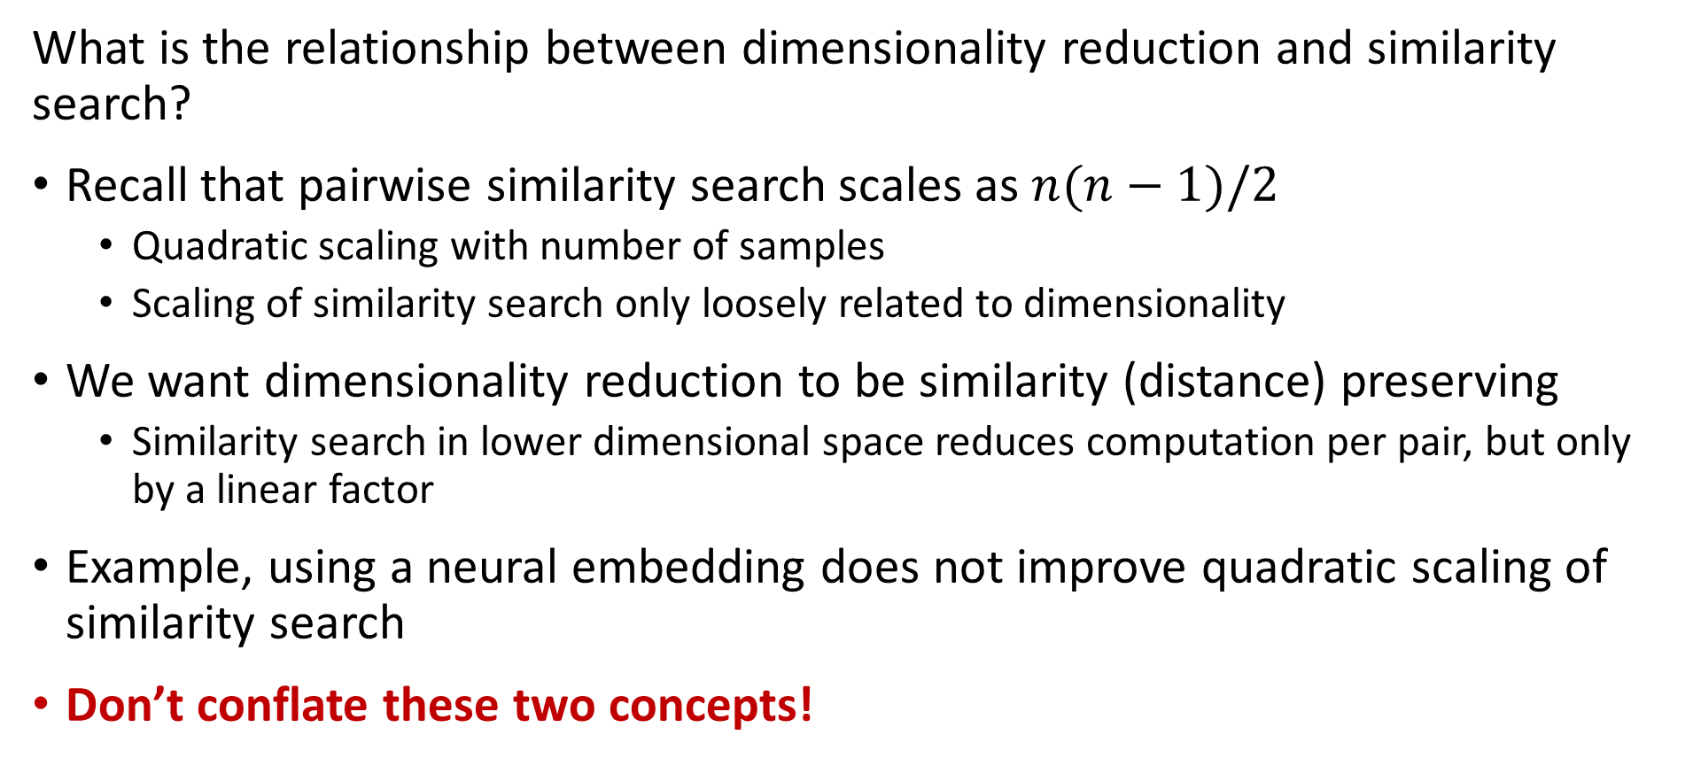
Introduction to Dimensionality Reduction
What is the relationship between dimensionality reduction and similarity search?
Recall that pairwise similarity search scales as $n(n−1)/2$
Quadratic scaling with number of samples
Scaling of similarity search only loosely related to dimensionality
We want dimensionality reduction to be similarity (distance) preserving
Similarity search in lower dimensional space reduces computation per pair, but only by a linear factor
Example, using a neural embedding does not improve quadratic scaling of similarity search
Don’t conflate these two concepts!

Slide 6
Projection Methods

Slide 7
Random Projection Methods
How can we overcome the curse of dimensionality?
Random projection methods sample random directions
Introduced in several contexts, including by Bingham and Mannila, 2001 and Achliptas, 2001
Alternative to PCA for very high dimensional spaces
Error of the random projection to lower dimensional space is bounded
Distance is therefore preserved
Random projections in Euclidean space tend to create spherical clusters
Spherical clusters are easier for many algorithms to deal with

Slide 8
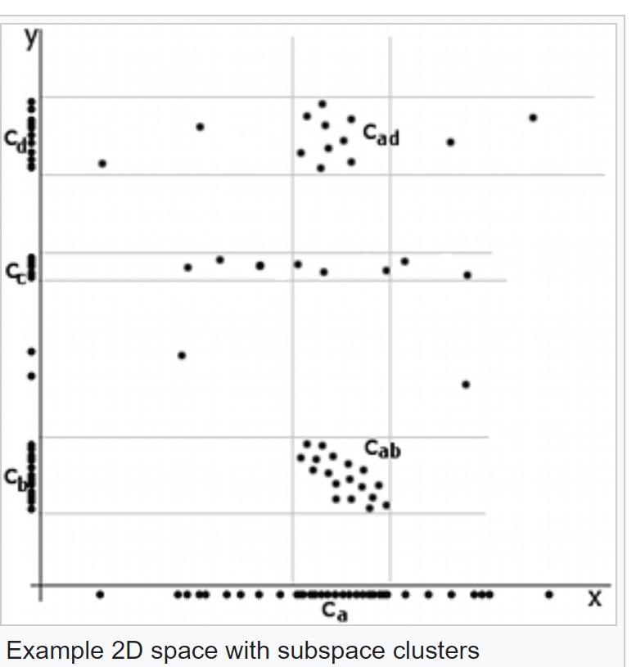
Random Projection Methods
Example of difficult dimensionality reduction
Cluster centers aligned along x axis
Apparent cluster along y axis
No apparent cluster along x axis
Credit Wikipedia commons

Slide 9
Random Projection Methods
Example of difficult dimensionality reduction
Highest variance direction aligned with axis
Eigenvector for largest eigenvalue along axis!
Principal components same as axes
No dimensionality reduction
First Principal Component
Credit Wikipedia commons
Second Principle Component

Slide 10
Random Projection Methods
Example of difficult dimensionality reduction
Cluster models will struggle
2 well defined clusters on both components
Cluster with low variance on first component, dispersed along second component
- Not a spherical cluster!
First Principal Component
Credit Wikipedia commons
Second Principle Component

Slide 11
Subspace Projection Methods
How can we extend clustering to higher dimensions?
Subspace clustering samples many subspaces to find embedding
Limited scalability since there are infinite possible subspaces
Heuristic, based on downward closure property, improves scalability - addressed in a subsequent lesson
Python subspace clustering package in Chong You’s GitHub repository
We will not pursue this method further here
Random projection methods are a better alternative in many cases

Slide 12
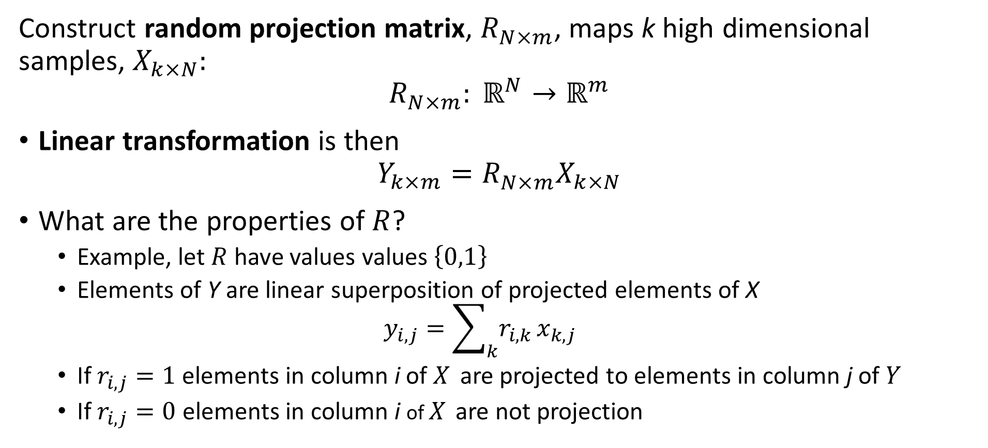
Random Projection Methods
Construct random projection matrix, $R_{N×m}^{ }$, maps k high dimensional samples, $X_{k×N}:$
$${R_{N×m}^{ }: ℝ}^{N}→ℝ^{m}$$
Linear transformation is then
$$Y_{k×m}=R_{N×m}^{ }X_{k×N}$$
What are the properties of $R$?
Example, let $R$ have values values $\left\{0,1\right\}$
Elements of Y are linear superposition of projected elements of X
$$y_{i,j}=\sum_{k}{r_{i,k}}x_{k,j}$$
If $r_{i,j}=1$ elements in column i of $X_{ }$ are projected to elements in column j of $Y$
If $r_{i,j}=0$ elements in column i of $X_{ }$ are not projection

Slide 13
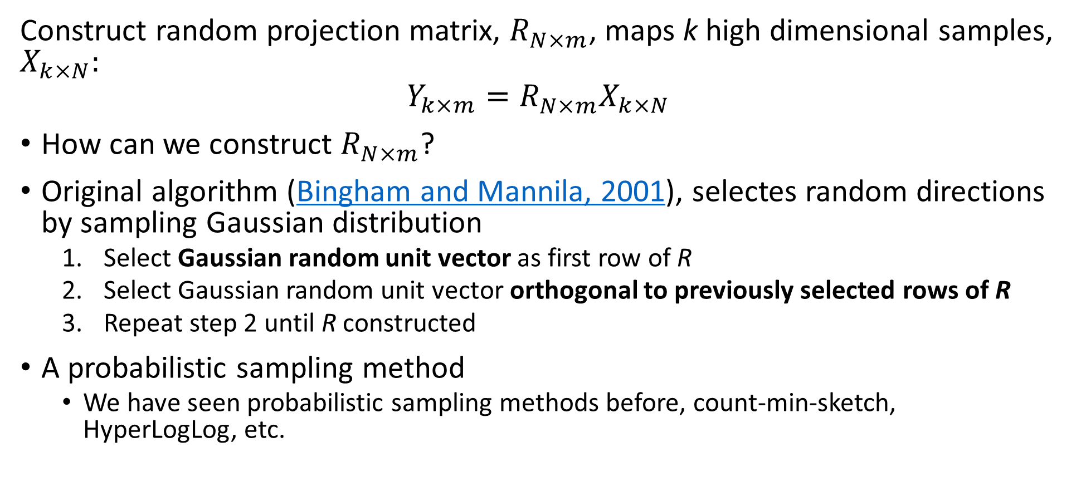
Random Projection Methods
Construct random projection matrix, $R_{N×m}^{ }$, maps k high dimensional samples, $X_{k×N}:$
$$Y_{k×m}=R_{N×m}^{ }X_{k×N}$$
How can we construct $R_{N×m}^{ }$?
Original algorithm (Bingham and Mannila, 2001), selectes random directions by sampling Gaussian distribution
Select Gaussian random unit vector as first row of R
Select Gaussian random unit vector orthogonal to previously selected rows of R
Repeat step 2 until R constructed
A probabilistic sampling method
We have seen probabilistic sampling methods before, count-min-sketch, HyperLogLog, etc.

Slide 14
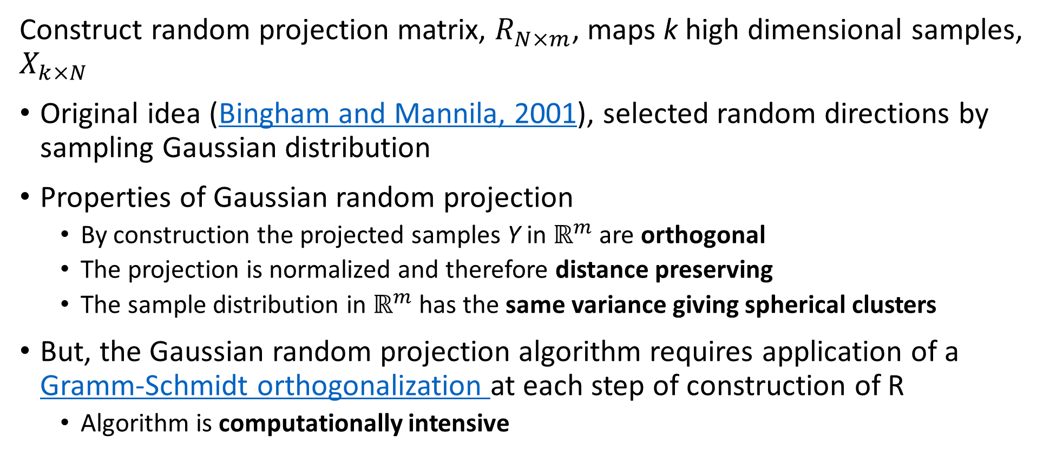
Random Projection Methods
Construct random projection matrix, $R_{N×m}^{ }$, maps k high dimensional samples, $X_{k×N}$
Original idea (Bingham and Mannila, 2001), selected random directions by sampling Gaussian distribution
Properties of Gaussian random projection
By construction the projected samples Y in $ℝ^{m}$ are orthogonal
The projection is normalized and therefore distance preserving
The sample distribution in $ℝ^{m}$ has the same variance giving spherical clusters
But, the Gaussian random projection algorithm requires application of a Gramm-Schmidt orthogonalization at each step of construction of R
Algorithm is computationally intensive

Slide 15
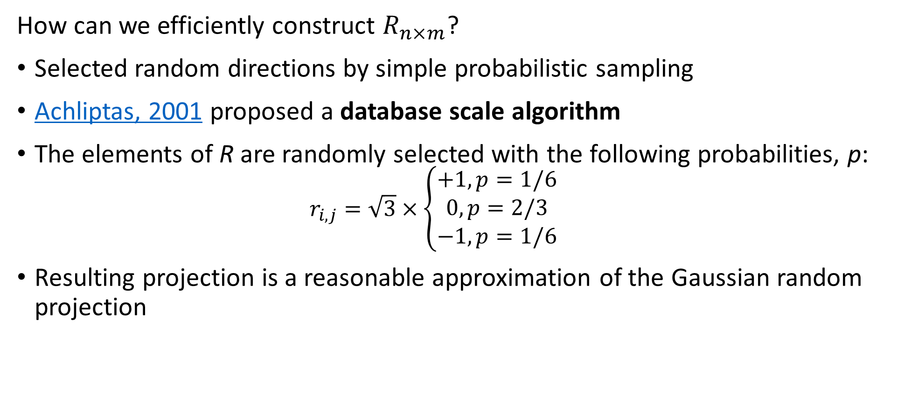
Random Projection Methods
How can we efficiently construct $R_{n×m}^{ }$?
Selected random directions by simple probabilistic sampling
Achliptas, 2001 proposed a database scale algorithm
The elements of R are randomly selected with the following probabilities, p:
$$r_{i,j}=\sqrt{3}×\left\{\begin{aligned}+1, p=1/6 \\ 0, p=2/3 \\ −1, p=1/6\end{aligned}\right.$$
Resulting projection is a reasonable approximation of the Gaussian random projection

Slide 16
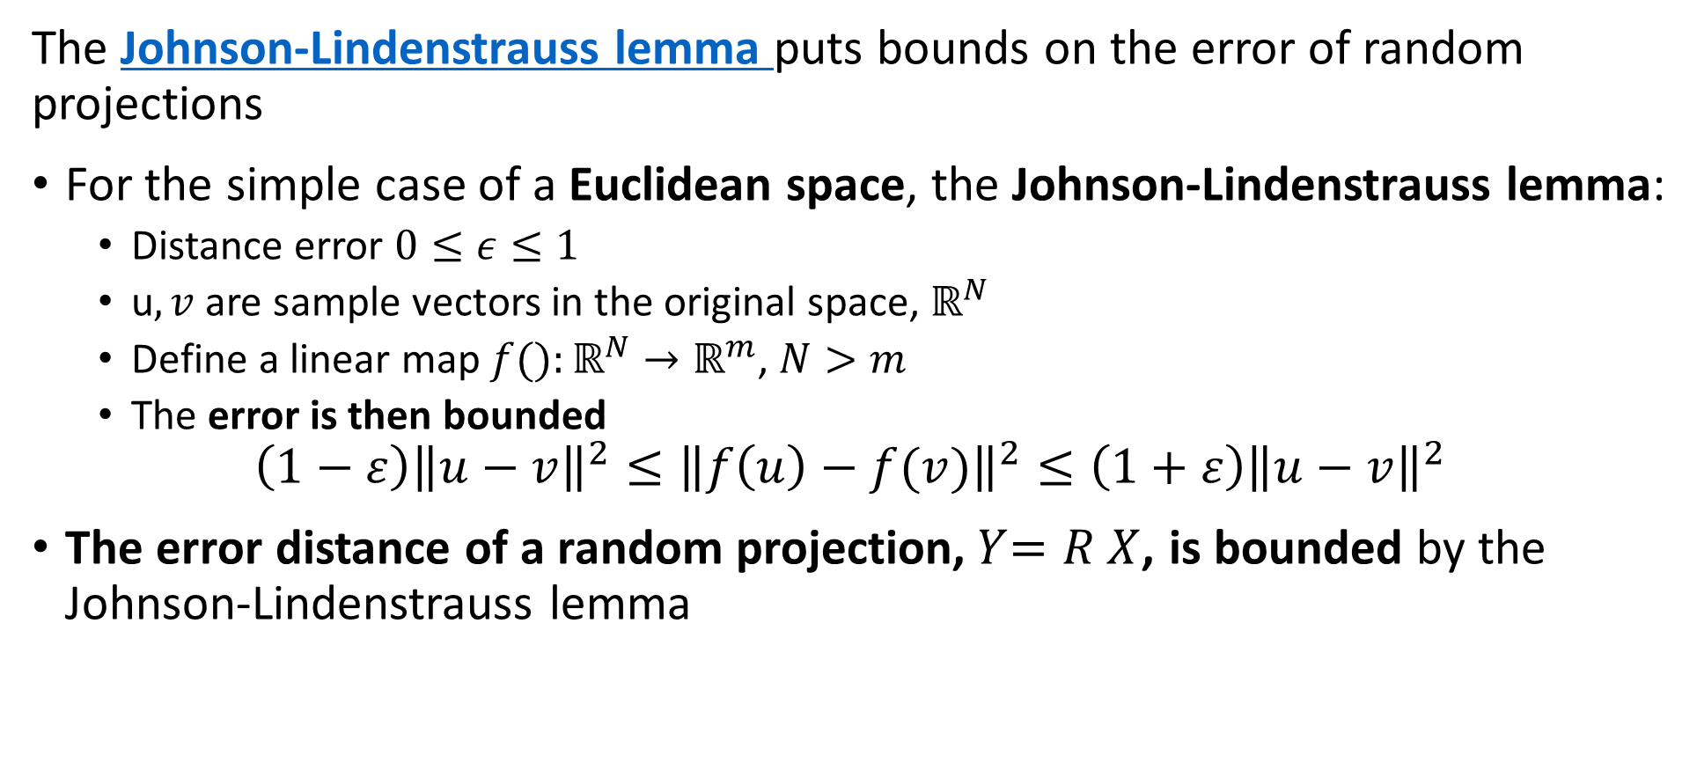
Random Projection Methods
The Johnson-Lindenstrauss lemma puts bounds on the error of random projections
For the simple case of a Euclidean space, the Johnson-Lindenstrauss lemma:
Distance error $0≤ε≤1$
u$,v$ are sample vectors in the original space, $ℝ^{N}$
Define a linear map $f():ℝ^{N}→ℝ^{m}$, $N>m$
The error is then bounded
$$\left(1−ε\right){\left\|u−v\right\|}^{2}≤{\left\|f\left(u\right)−f(v)\right\|}^{2}≤\left(1+ε\right){\left\|u−v\right\|}^{2}$$
The error distance of a random projection,${ Y}_{ }=R_{ }^{ }X$, is bounded by the Johnson-Lindenstrauss lemma

Slide 17
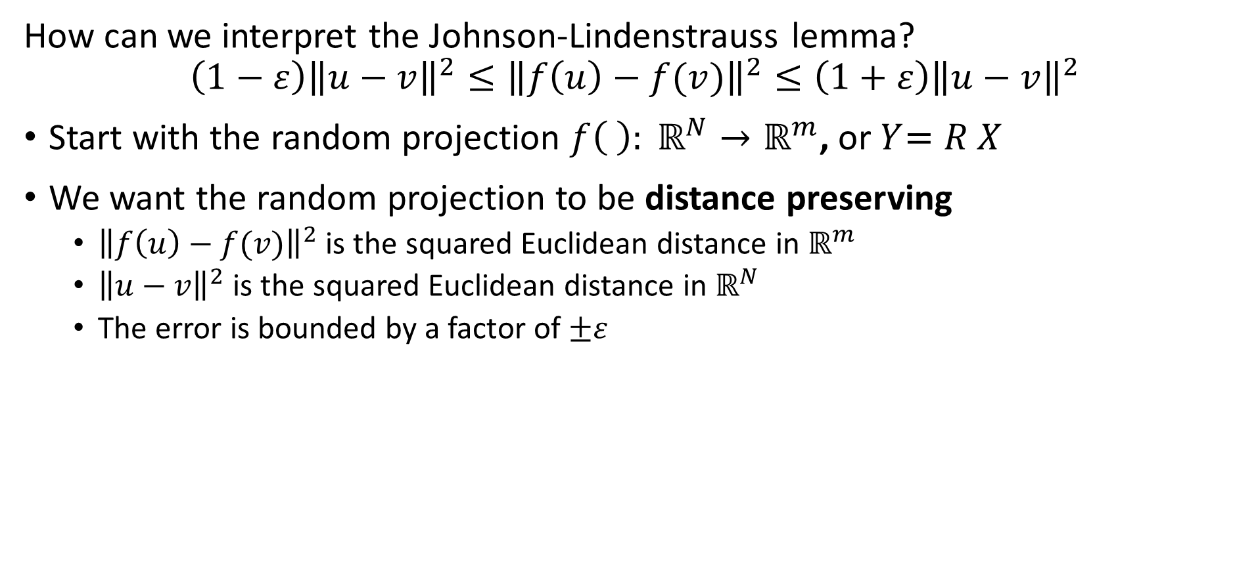
Random Projection Methods
How can we interpret the Johnson-Lindenstrauss lemma?
$$\left(1−ε\right){\left\|u−v\right\|}^{2}≤{\left\|f\left(u\right)−f(v)\right\|}^{2}≤\left(1+ε\right){\left\|u−v\right\|}^{2}$$
Start with the random projection ${f\left( \right): ℝ}^{N}→ℝ^{m}$, or${ Y}_{ }=R_{ }^{ }X$
We want the random projection to be distance preserving
${\left\|f\left(u\right)−f(v)\right\|}^{2}$ is the squared Euclidean distance in $ℝ^{m}$
${\left\|u−v\right\|}^{2}$ is the squared Euclidean distance in $ℝ^{N}$
The error is bounded by a factor of $±ε$

Slide 18
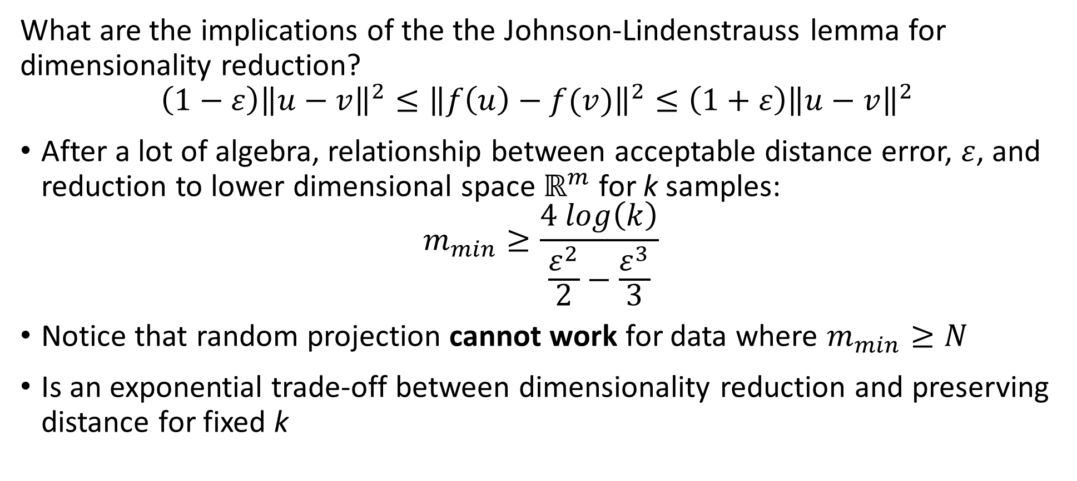
Random Projection Methods
What are the implications of the the Johnson-Lindenstrauss lemma for dimensionality reduction?
$$\left(1−ε\right){\left\|u−v\right\|}^{2}≤{\left\|f\left(u\right)−f(v)\right\|}^{2}≤\left(1+ε\right){\left\|u−v\right\|}^{2}$$
After a lot of algebra, relationship between acceptable distance error, $ε$, and reduction to lower dimensional space $ℝ^{m}$ for k samples:
$$m_{min}≥\frac{4 log\left(k\right)}{\frac{ε^{2}}{2}−\frac{ε^{3}}{3}}$$
Notice that random projection cannot work for data where $m_{min}≥N$
Is an exponential trade-off between dimensionality reduction and preserving distance for fixed k

Slide 19
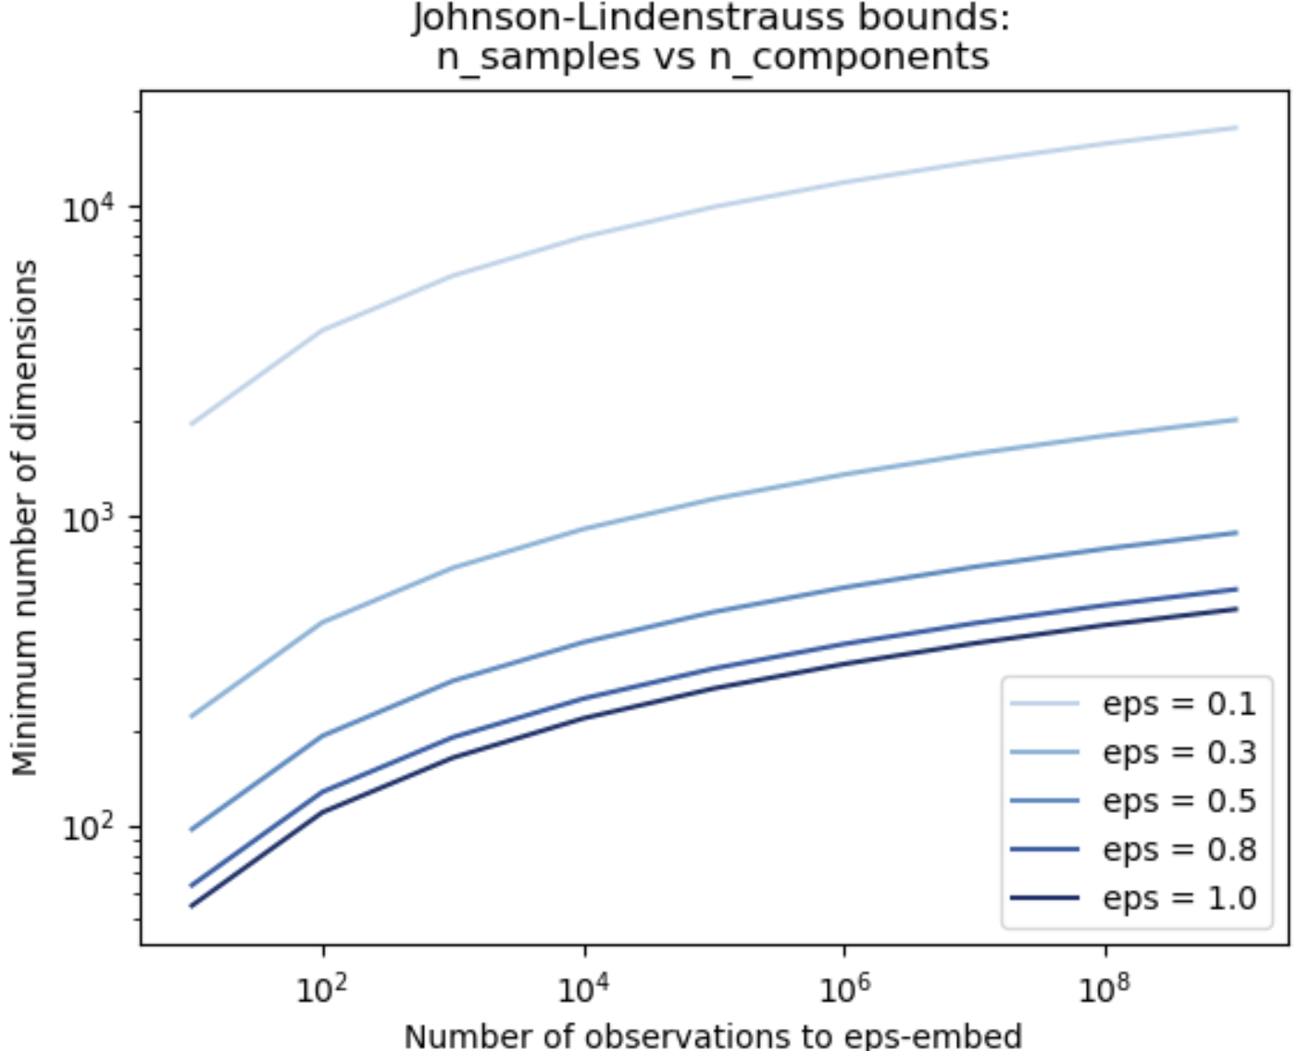
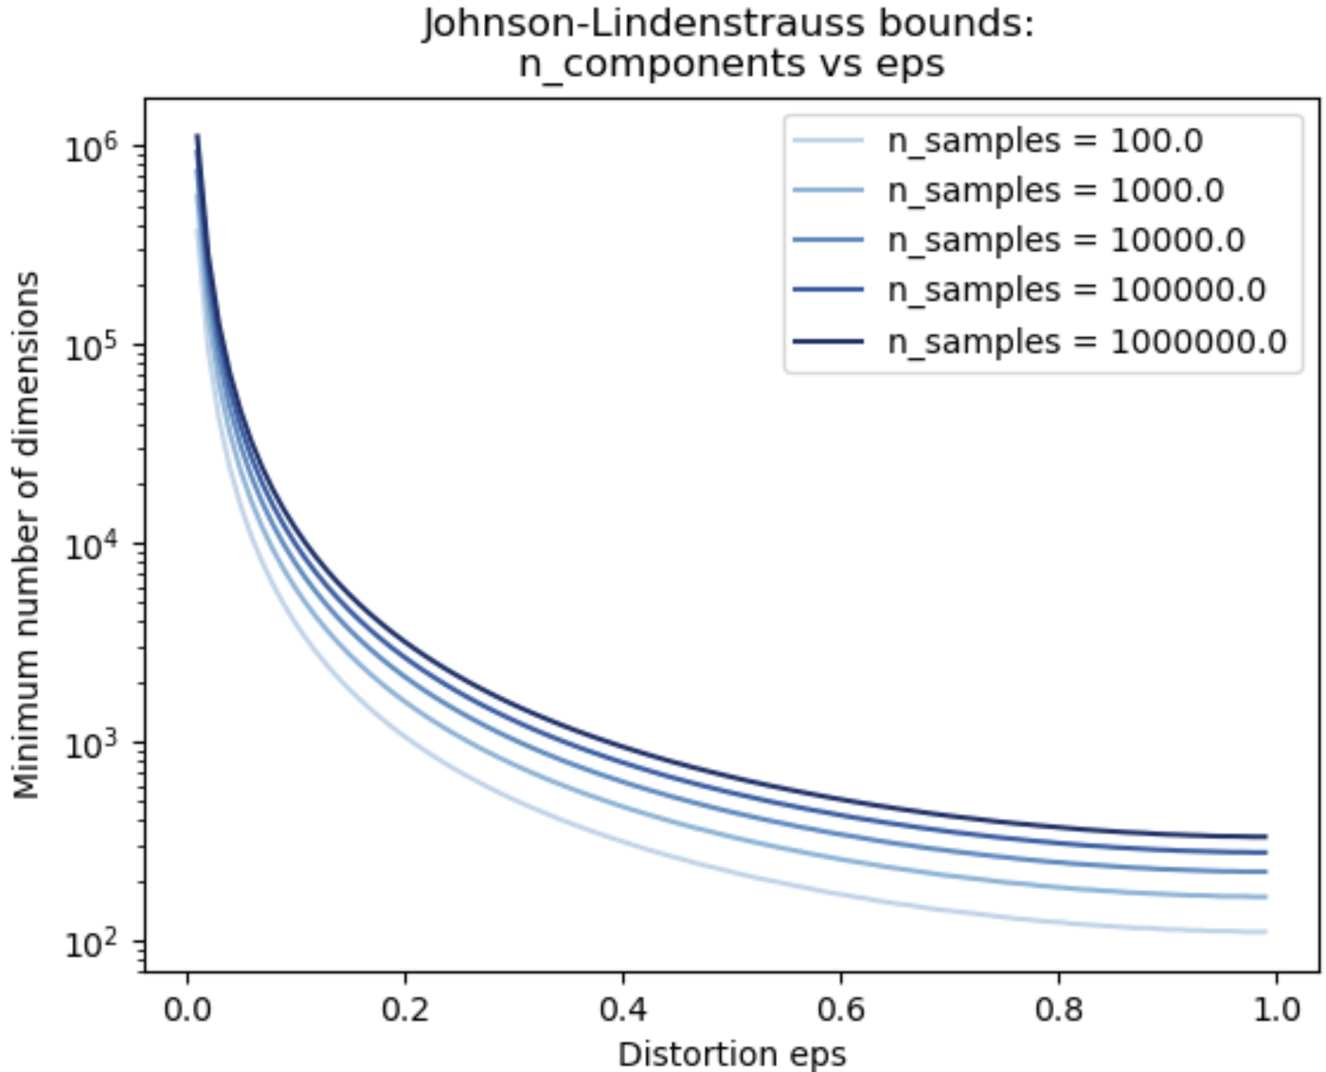
Random Projection Methods
Exponential trade-off between dimensionality reduction and preserving distance
Credit: Scikit-Learn team

Slide 20
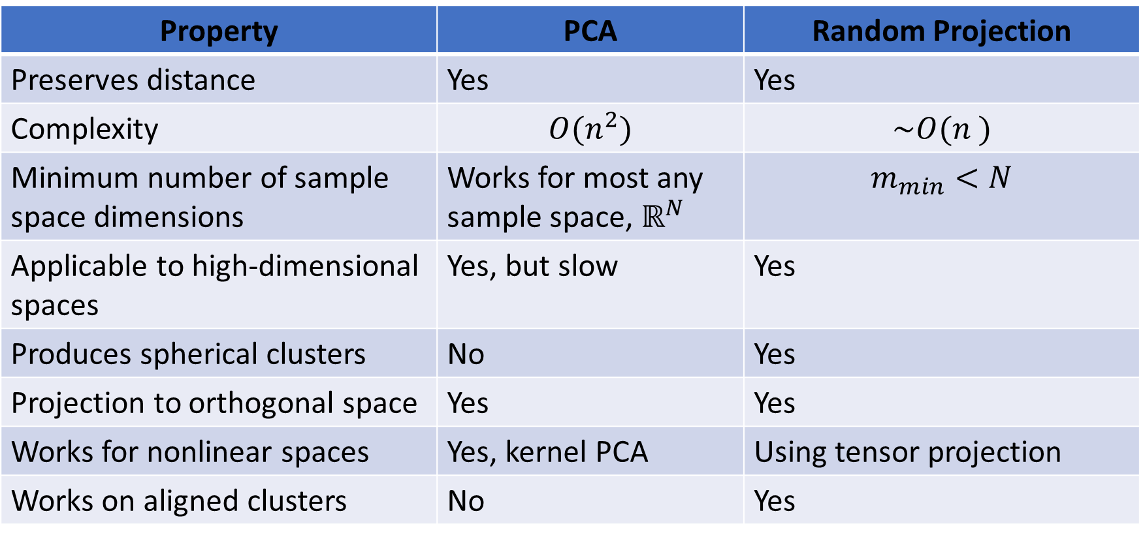
Random Projection Methods
How does random projection compare to PCA?
Property | PCA | Random Projection
Preserves distance | Yes | Yes
Complexity | $$O(n^{2})$$ | $$\sim O(n^{ })$$
Minimum number of sample space dimensions | Works for most any sample space, $ℝ^{N}$ | $$m_{min}<N$$
Applicable to high-dimensional spaces | Yes, but slow | Yes
Produces spherical clusters | No | Yes
Projection to orthogonal space | Yes | Yes
Works for nonlinear spaces | Yes, kernel PCA | Using tensor projection
Works on aligned clusters | No | Yes

Slide 21
Manifold Learning

Slide 22
Manifold Learning
How can we visualize data from higher dimensions?
Reducing dimensionality can help
Need to create a lower dimensional embedding
But how?
Manifold Learning finds projection of high-dimensional space onto a low-dimensional manifold
Many commonly used unsupervised methods
Spectral embedding
Uniform Manifold Approximation and Projection (UMAP)
t-distributed Stochastic Neighbor Embedding (t-SNE) – largely supplanted by UMAP
…..

Slide 23
Manifold Learning
Map high-dimensional space to a low dimensional manifold
A manifold is a low dimensional surface in a high-dimensional space
Linear manifold is a hyperplane – PCA, SVD
Nonlinear manifolds for more complex embeddings – our focus
Often used as a visualization technique
Human perception generally fails beyond a few dimensions
Mapping to a manifold creates low-dimensional projection of complex data relationships

Slide 24
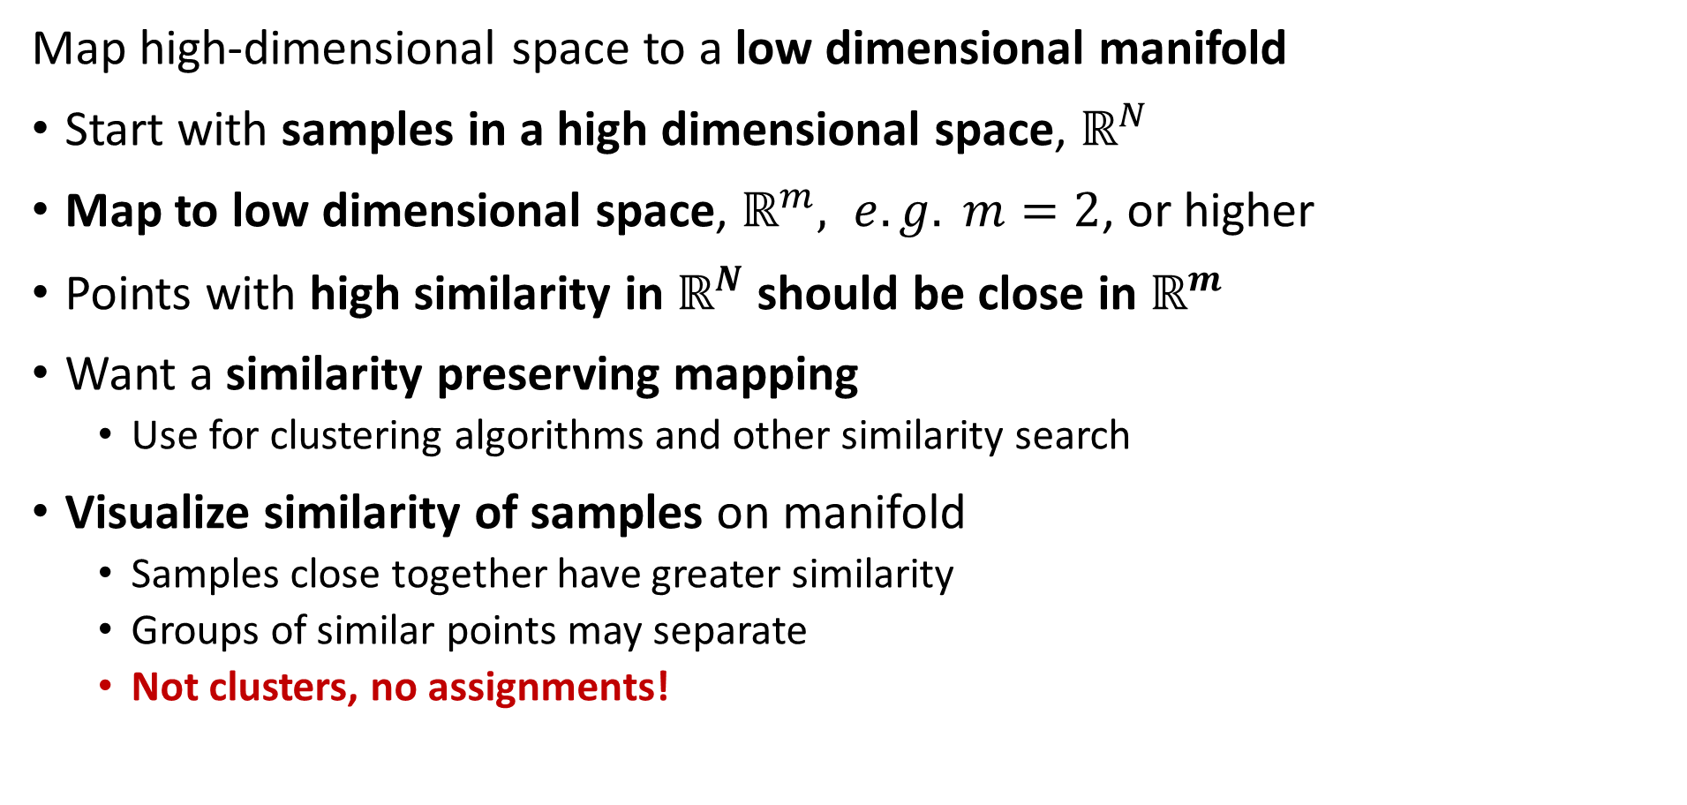
Manifold Learning
Map high-dimensional space to a low dimensional manifold
Start with samples in a high dimensional space, $ℝ^{N}$
Map to low dimensional space, $ℝ^{m}, e.g. m=2$, or higher
Points with high similarity in $ℝ^{N}$ should be close in $ℝ^{m}$
Want a similarity preserving mapping
Use for clustering algorithms and other similarity search
Visualize similarity of samples on manifold
Samples close together have greater similarity
Groups of similar points may separate
Not clusters, no assignments!

Slide 25
Manifold Learning
Map high-dimensional space to a low dimensional manifold
Many algorithms have been developed
Scikit-Learn supports 8 algorithms + PCA
Projection of PCs is on a linear manifold or hyperplane
Kernal PCA maps to nonlinear manifold
We will look at two unsupervised algorithms in detail:
Spectral embedding
UMAP

Slide 26
Spectral Embedding

Slide 27
Spectral Embedding
Spectral embedding uses graph-based construction
Creates a low-dimensional map of high dimensional space
Closely related to spectral clustering algorithm
Uses eigendecomposition of graph Laplacian
Maps to nonlinear manifold from high-dimensional space
Preserves distances of most similar pairs on graph
Supported in Scikit-Learn

Slide 28
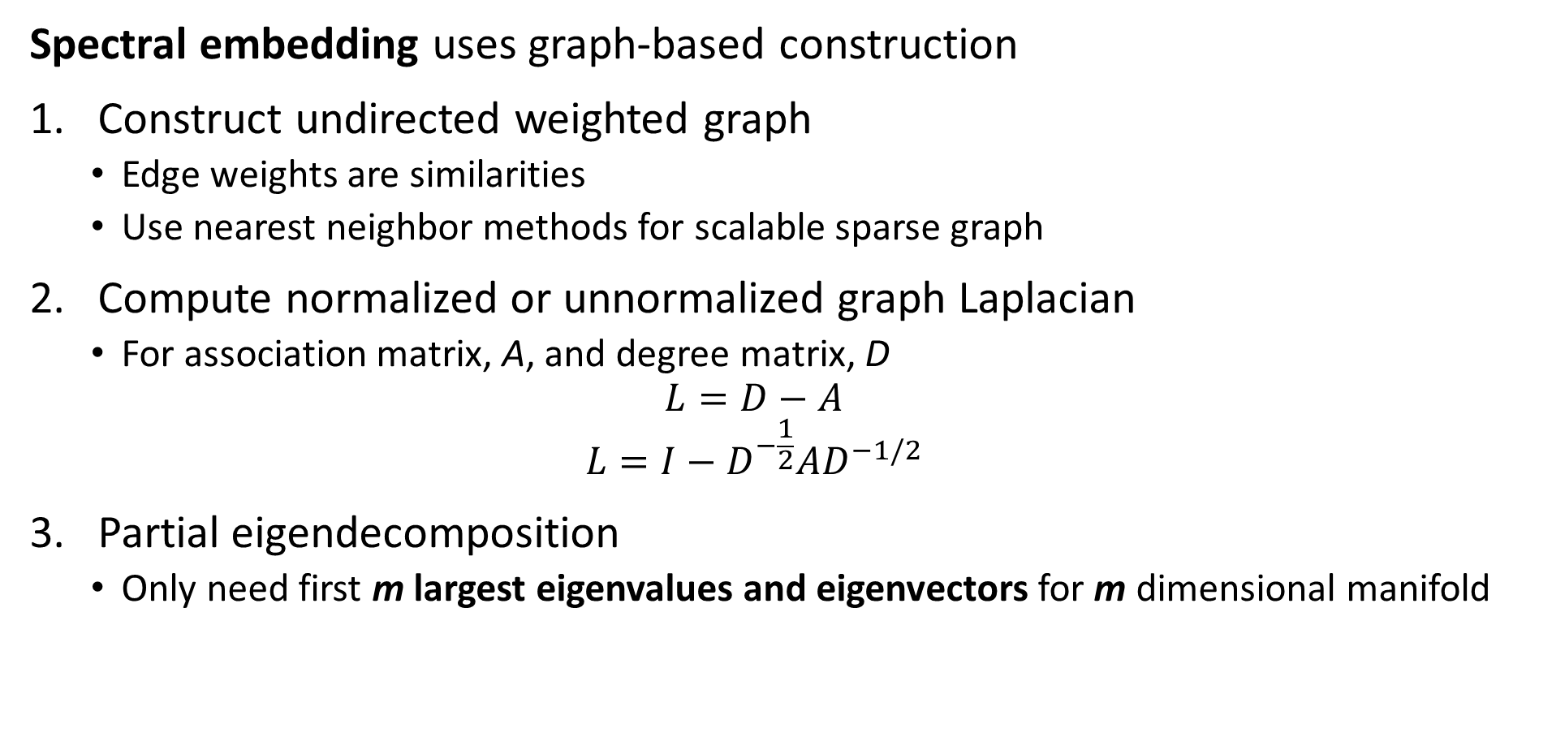
Spectral Embedding
Spectral embedding uses graph-based construction
Construct undirected weighted graph
Edge weights are similarities
Use nearest neighbor methods for scalable sparse graph
Compute normalized or unnormalized graph Laplacian
For association matrix, A, and degree matrix, D
$$L=D−A$$
$$L={I−D}^{−\frac{1}{2}}AD^{−1/2}$$
Partial eigendecomposition
Only need first m largest eigenvalues and eigenvectors for m dimensional manifold

Slide 29
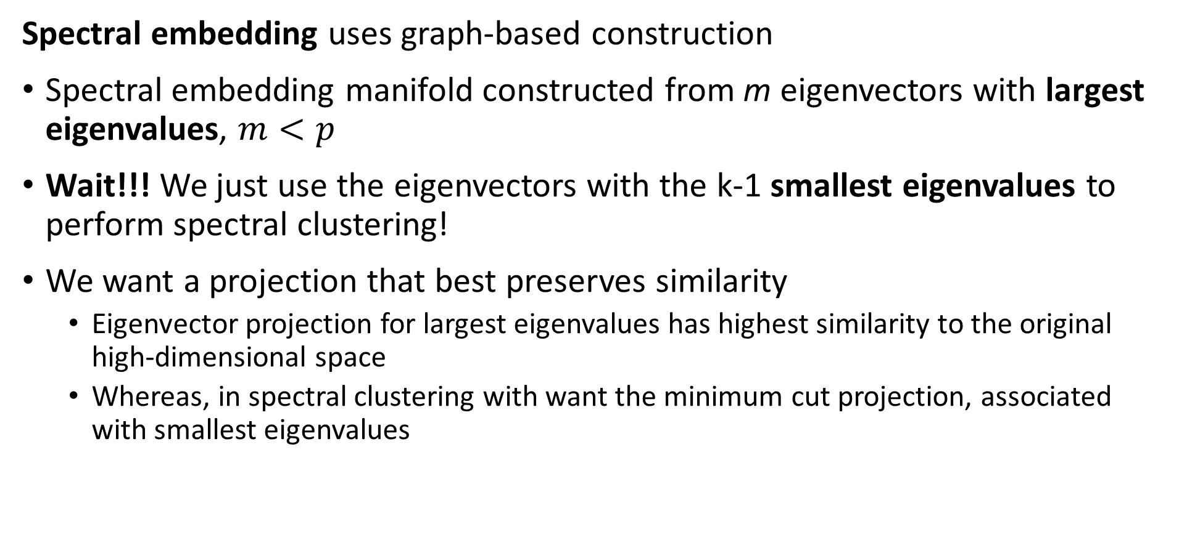
Spectral Embedding
Spectral embedding uses graph-based construction
Spectral embedding manifold constructed from m eigenvectors with largest eigenvalues, $m<p$
Wait!!! We just use the eigenvectors with the k-1 smallest eigenvalues to perform spectral clustering!
We want a projection that best preserves similarity
Eigenvector projection for largest eigenvalues has highest similarity to the original high-dimensional space
Whereas, in spectral clustering with want the minimum cut projection, associated with smallest eigenvalues

Slide 30
Uniform Manifold Approximation and Projection (UMAP)

Slide 31
Uniform Manifold Approximation and Projection (UMAP)
UMAP maps to a low-dimensional manifold from a nearest-neighbor graph
UMAP is (arguably) the state of the art in manifold learning
A generalization of tSNE
Uses topological properties to create graph and map a metric space to a low-dimensional Euclidian manifold
UMAP attempts to preserve probability distribution and distance
Can be used to reduce dimensions for algorithms like clustering, retaining more dimensions
The UMAP package has Python and R APIs and is very well documented
There are many variations and applications
Read the docs!

Slide 32
Uniform Manifold Approximation and Projection (UMAP)
Key properties of UMAP
UMAP attempts to preserve probability distribution and distance
Assumes the observations on a manifold are locally connected and uniformly distributed
High-dimensional manifold can use most any distance metric
Low-dimensional manifold is Euclidean
Algorithm relies on properties of Reimann manifolds
Reimann manifolds are locally smooth
Reimann manifolds have continuous first derivatives

Slide 33
Uniform Manifold Approximation and Projection (UMAP)
Key properties of UMAP
Low-dimensional Euclidean Reimann manifold has desirable properties
Human perception of visualizations good for Euclidean space
Euclidean space has advantages for machine learning
Wide choice of possible algorithms
Can compute sum of squares
Clusters are elliptical or spherical

Slide 34
Uniform Manifold Approximation and Projection (UMAP)
How does the UMAP algorithm work?
Algorithm for mapping to low dimensional Euclidian space has 4 major steps:
Locally compute fuzzy weights
Build nearest-neighbor graph
Use spectral embedding to find good starting transformation
Minimize cross-entropy to optimize low-dimensional Euclidian manifold

Slide 35
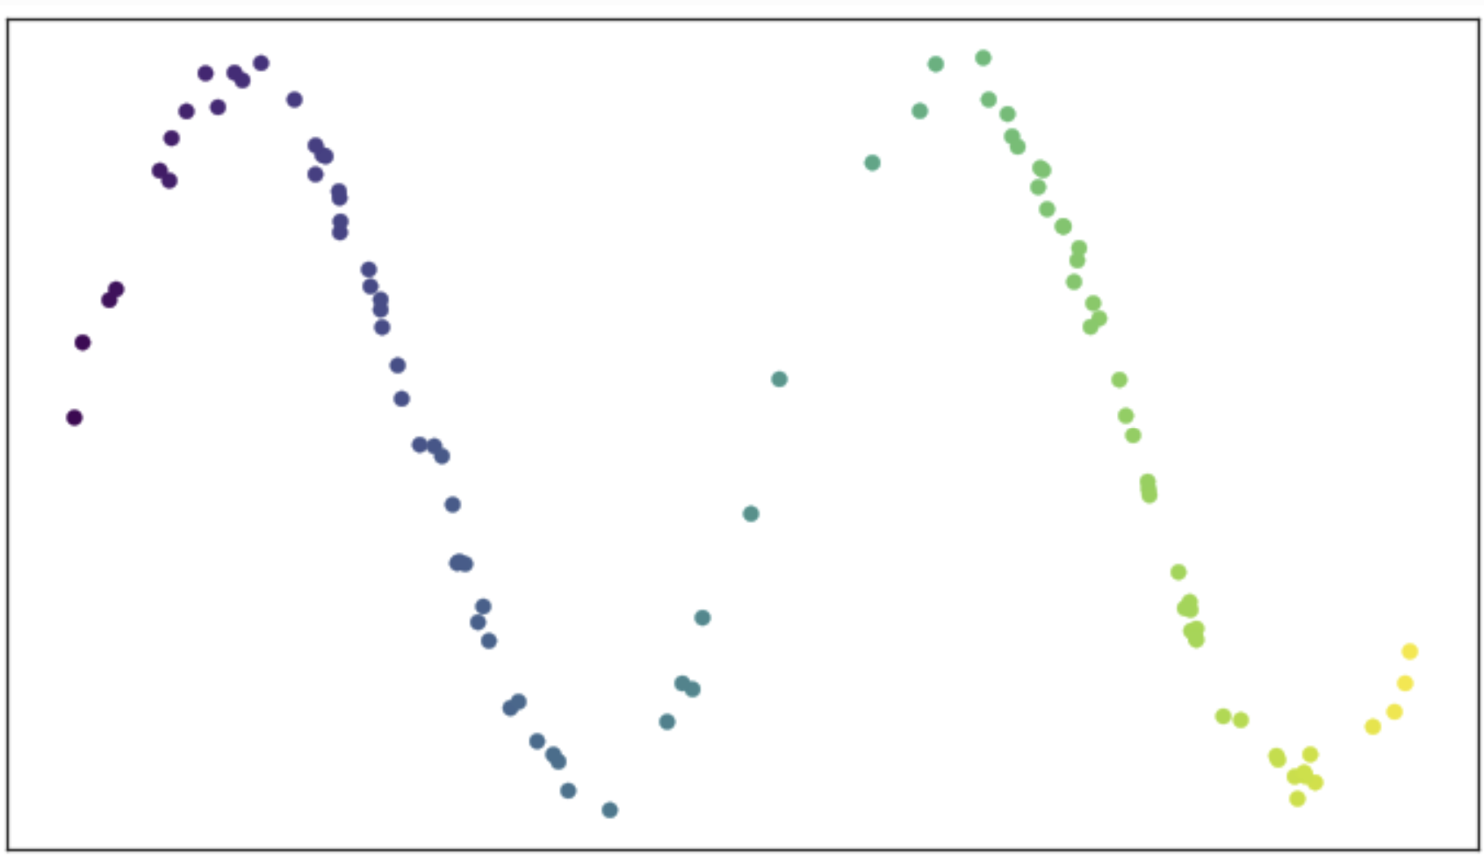
Uniform Manifold Approximation and Projection (UMAP)
How does the UMAP algorithm work?
Consider an example of data on a manifold
Is a two-dimensional space
Sample values are predominantly on a 1-dimensional smooth (Reimann) manifold
How do we construct the low-dimensional manifold?
From UMAP documentation, Leland McInnis, 2018

Slide 36
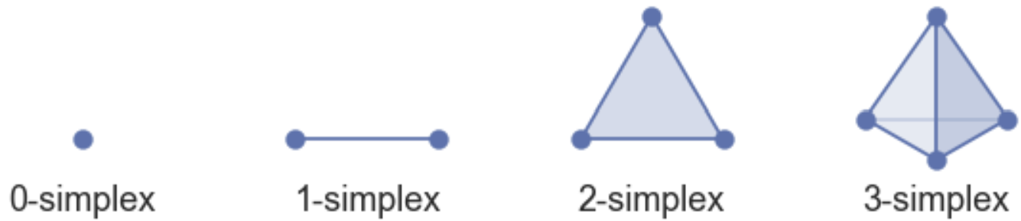
Uniform Manifold Approximation and Projection (UMAP)
How does the UMAP algorithm work?
Construct the manifold as a set of simplexes
K-simplex has k+1 fully connected nodes
Can construct high-dimensional shapes by joining simplices
Simplices joined on common faces
Represent complex manifold as simplicial complexes
From UMAP documentation, Leland McInnis, 2018

Slide 37
Uniform Manifold Approximation and Projection (UMAP)
How does the UMAP algorithm work?
Example of simplicial complex construction
Start with some observations, 0-simplicies
Construct a first 1-simplex, joining faces of 2 0-simplicies
Add 2 more 1-simplices, constructing a first 2-simplex
Construct a second 2-simplex, creating a simplicial complex along the common face
Construct a third 2-simplex, extending the simplicial complex along the common face

Slide 38
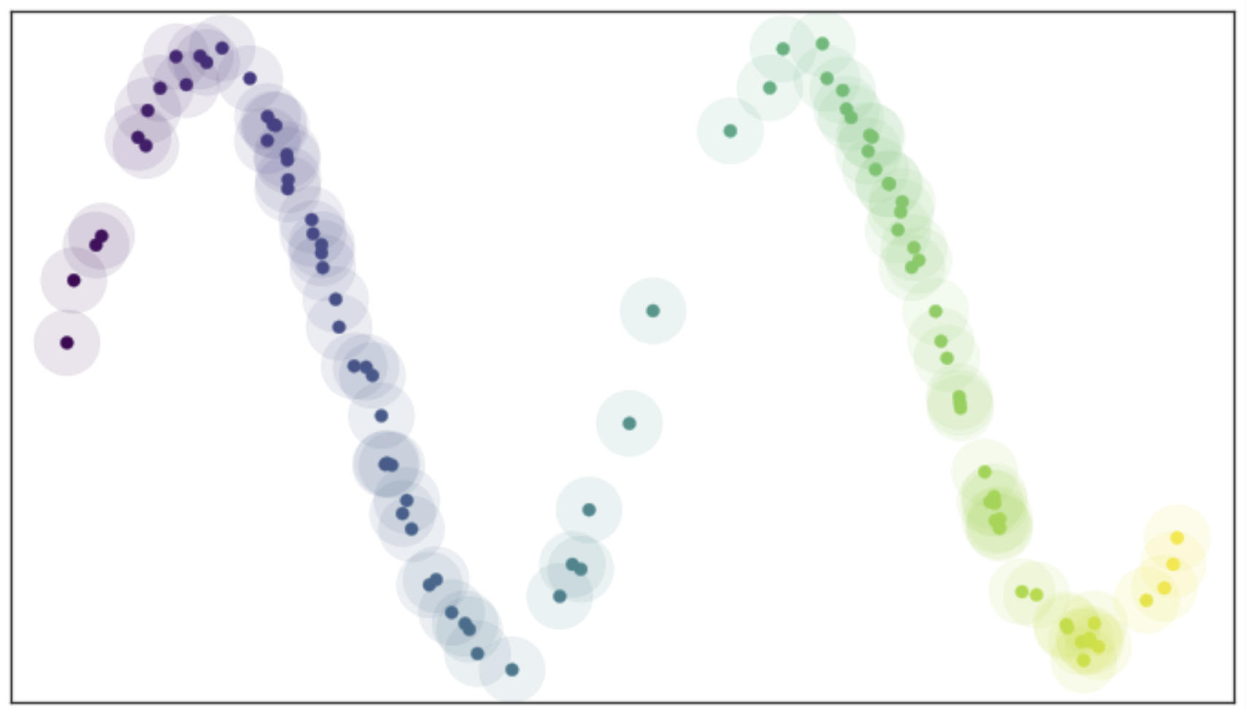
Uniform Manifold Approximation and Projection (UMAP)
How does the UMAP algorithm work?
Find manifold from connectivity of nearest neighbor graph
Place balls (circles in 2-d) of radius r on each point
Nearest neighbors within distance r
Ideal if vertices (observations) uniformly distributed
From UMAP documentation, Leland McInnis, 2018

Slide 39
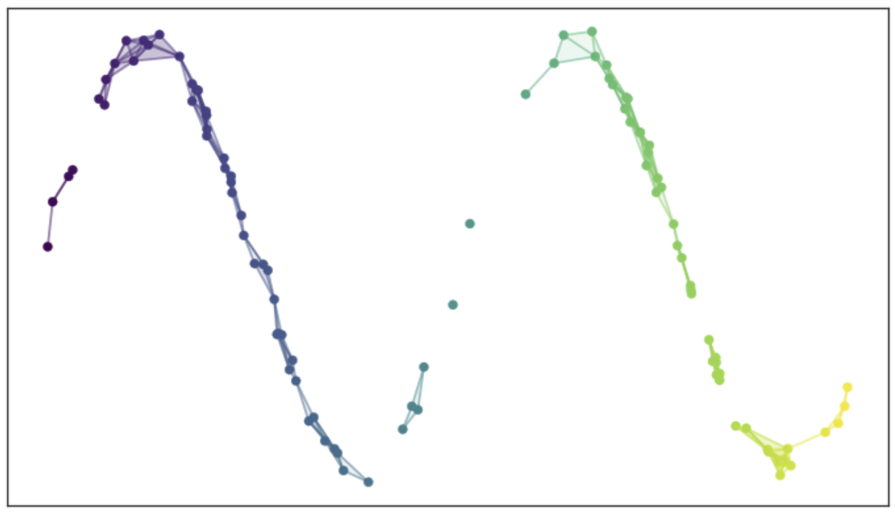
Uniform Manifold Approximation and Projection (UMAP)
How does the UMAP algorithm work?
Edges connect nearest neighbors within distance r
Graph may have disconnected components
The resulting graph is not ideal!
Too dense in some places
Discontinuous in other places
A poor representation of a smooth manifold
From UMAP documentation, Leland McInnis, 2018

Slide 40
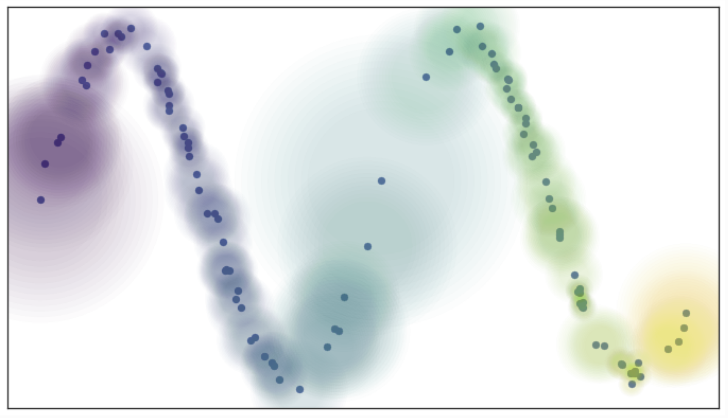
Uniform Manifold Approximation and Projection (UMAP)
How does the UMAP algorithm work?
Use ‘fuzzy balls’ to represent similarity
Example; probability (weight) of connection decays exponentially
Connect vertices on the manifold that are not uniformly distributed
From UMAP documentation, Leland McInnis, 2018

Slide 41
Uniform Manifold Approximation and Projection (UMAP)
How does the UMAP algorithm work?
Size of fuzzy ball determined by local density metric
Works since we assume a Reimann manifold, smooth and continuous first derivatives
From UMAP documentation, Leland McInnis, 2018

Slide 42
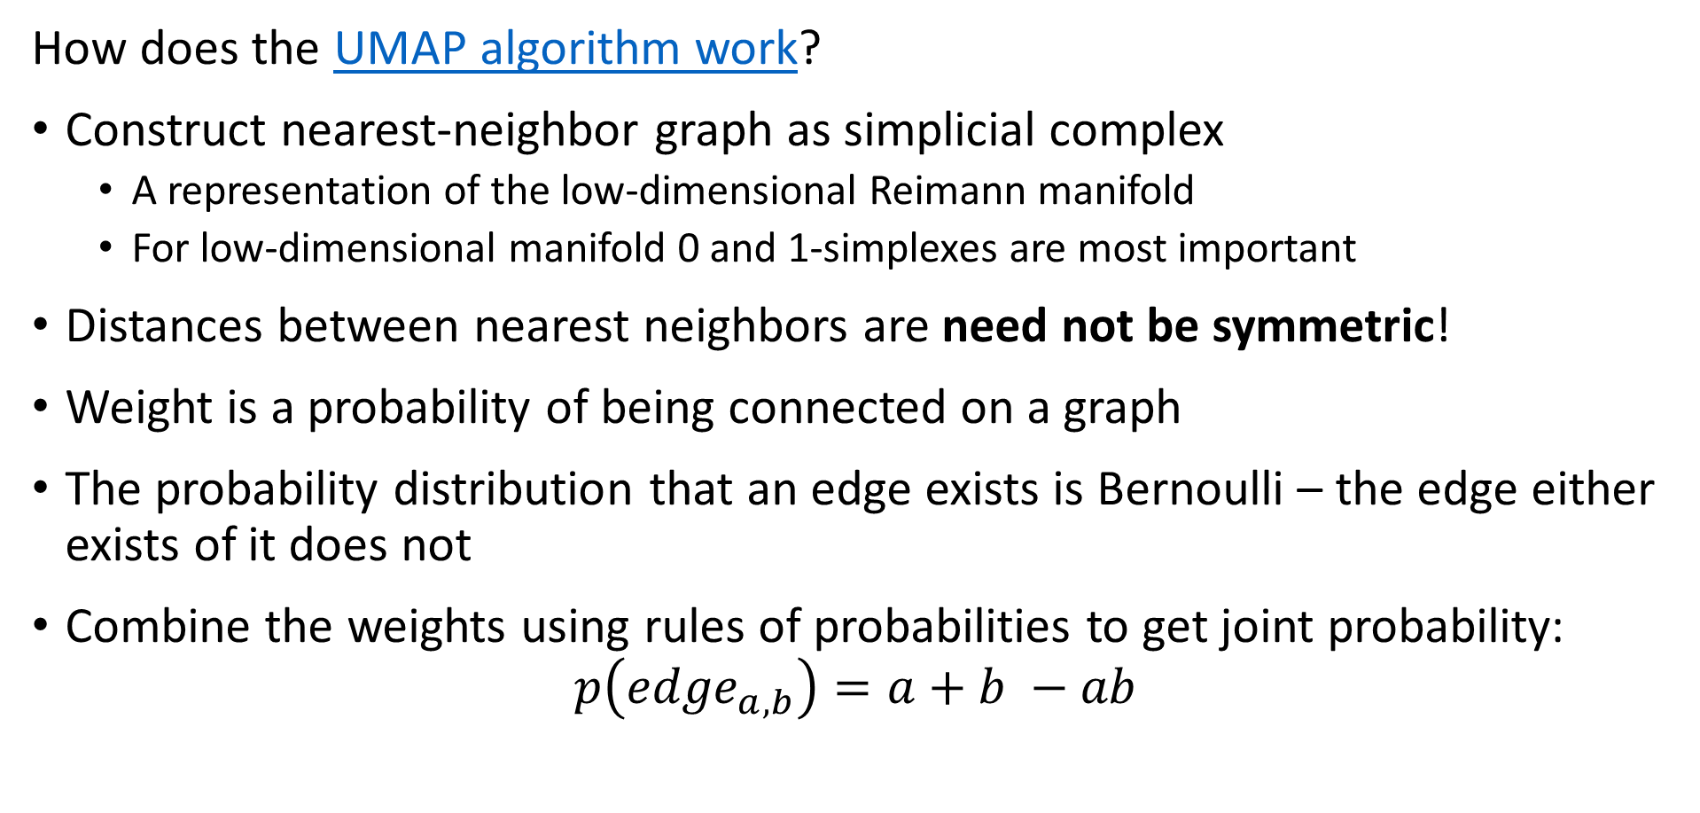
Uniform Manifold Approximation and Projection (UMAP)
How does the UMAP algorithm work?
Construct nearest-neighbor graph as simplicial complex
A representation of the low-dimensional Reimann manifold
For low-dimensional manifold 0 and 1-simplexes are most important
Distances between nearest neighbors are need not be symmetric!
Weight is a probability of being connected on a graph
The probability distribution that an edge exists is Bernoulli – the edge either exists of it does not
Combine the weights using rules of probabilities to get joint probability:
$$p\left({edge}_{a,b}\right)=a+b −ab$$

Slide 43
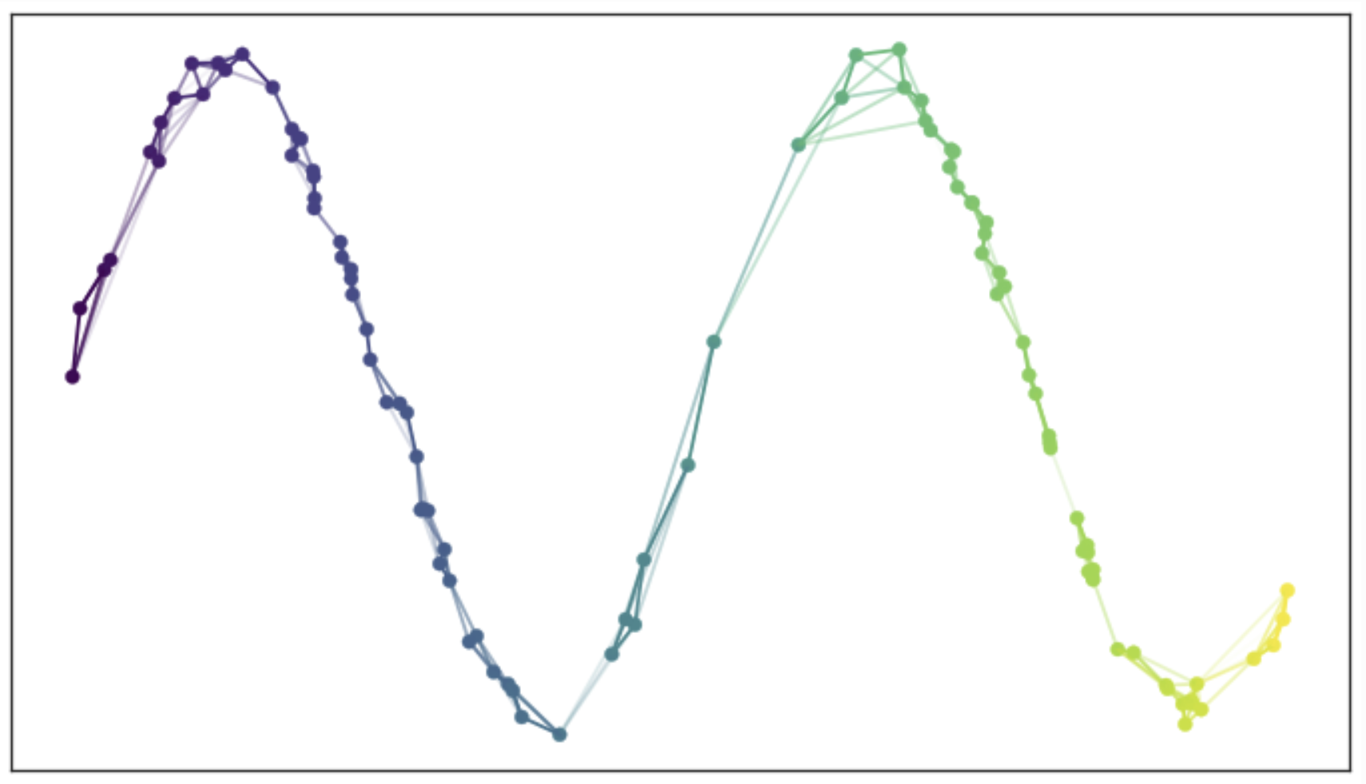
Uniform Manifold Approximation and Projection (UMAP)
How does the UMAP algorithm work?
Use the joint probabilities to define edges
Each observation is now connected to near neighbors in the simplicial complex
Graph is a map of the low-dimensional manifold
From UMAP documentation, Leland McInnis, 2018

Slide 44
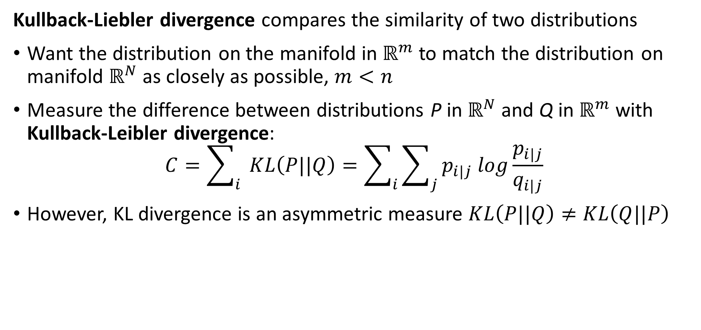
Uniform Manifold Approximation and Projection (UMAP)
Kullback-Liebler divergence compares the similarity of two distributions
Want the distribution on the manifold in $ℝ^{m}$ to match the distribution on manifold $ℝ^{N}$ as closely as possible, $m<n$
Measure the difference between distributions P in $ℝ^{N}$ and Q in $ℝ^{m}$ with Kullback-Leibler divergence:
$$C=\sum_{i}{ }KL\left(P||Q\right)=\sum_{i}{\sum_{j}{p_{i|j} log\frac{p_{i|j}}{q_{i|j}}}}$$
However, KL divergence is an asymmetric measure $KL\left(P||Q\right)≠KL\left(Q||P\right)$

Slide 45
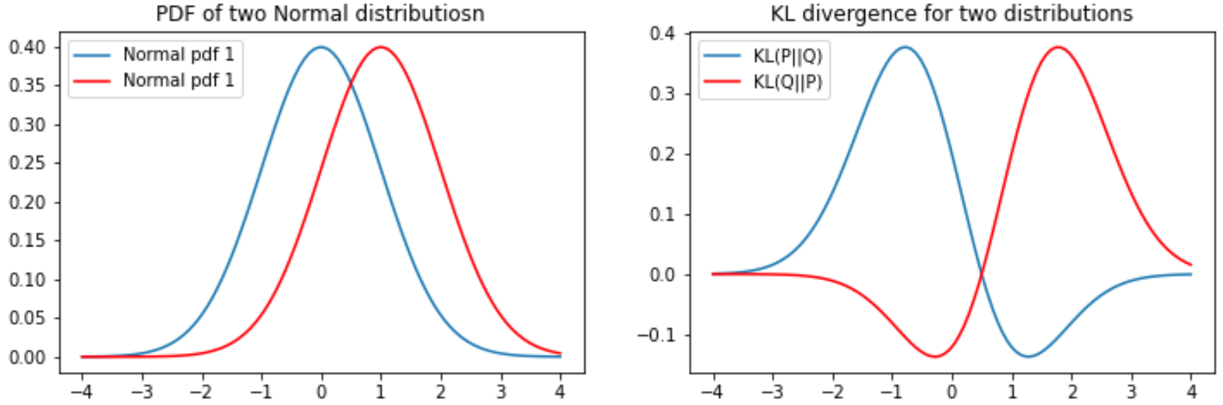
KL Divergence
The KL divergence is asymmetric
For two distributions the KL divergence depend on the order or arguments
Notice that the gradient becomes near zero on one side of the KL function

Slide 46
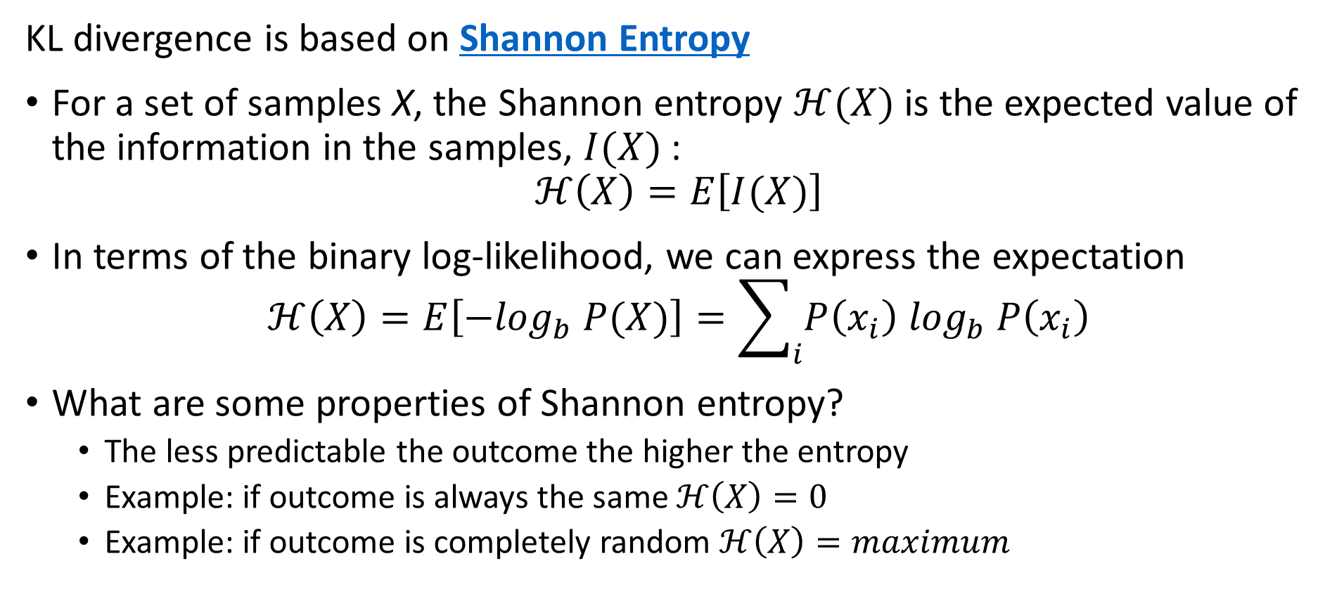
KL Divergence
KL divergence is based on Shannon Entropy
For a set of samples X, the Shannon entropy $ℋ(X)$ is the expected value of the information in the samples, $I(X)$:
$$ℋ\left(X\right)=E\left[I(X)\right]$$
In terms of the binary log-likelihood, we can express the expectation
$$ℋ\left(X\right)=E\left[{−log}_{b} P(X)\right]=\sum_{i}{P\left(x_{i}\right) \log_{b} P\left(x_{i}\right)}$$
What are some properties of Shannon entropy?
The less predictable the outcome the higher the entropy
Example: if outcome is always the same $ℋ\left(X\right)=0$
Example: if outcome is completely random $ℋ\left(X\right)=maximum$

Slide 47
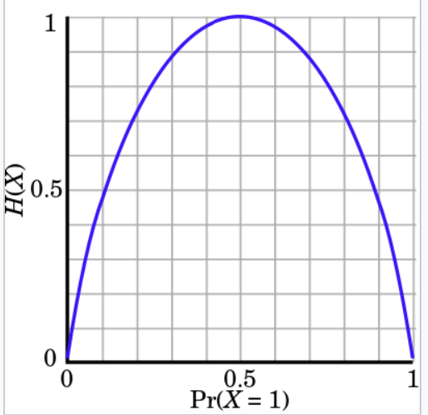
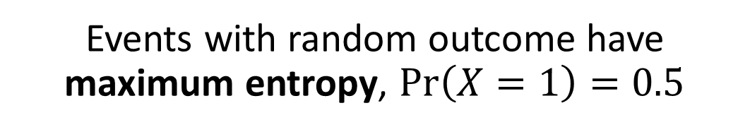
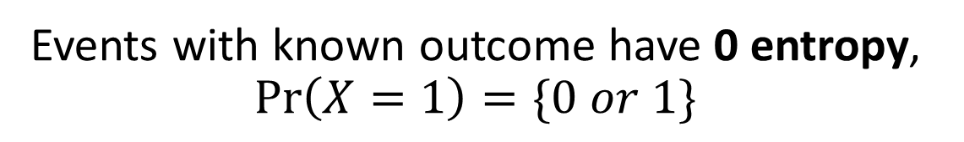
KL Divergence
Events with random outcome have maximum entropy, $\operatorname{Pr}\left(X=1\right)=0.5$
Understanding Shannon Entropy
Example: binomially distributed events
Events with known outcome have 0 entropy, $\operatorname{Pr}\left(X=1\right)=\{0 or 1\}$
Credit: Wikipedia commons

Slide 48
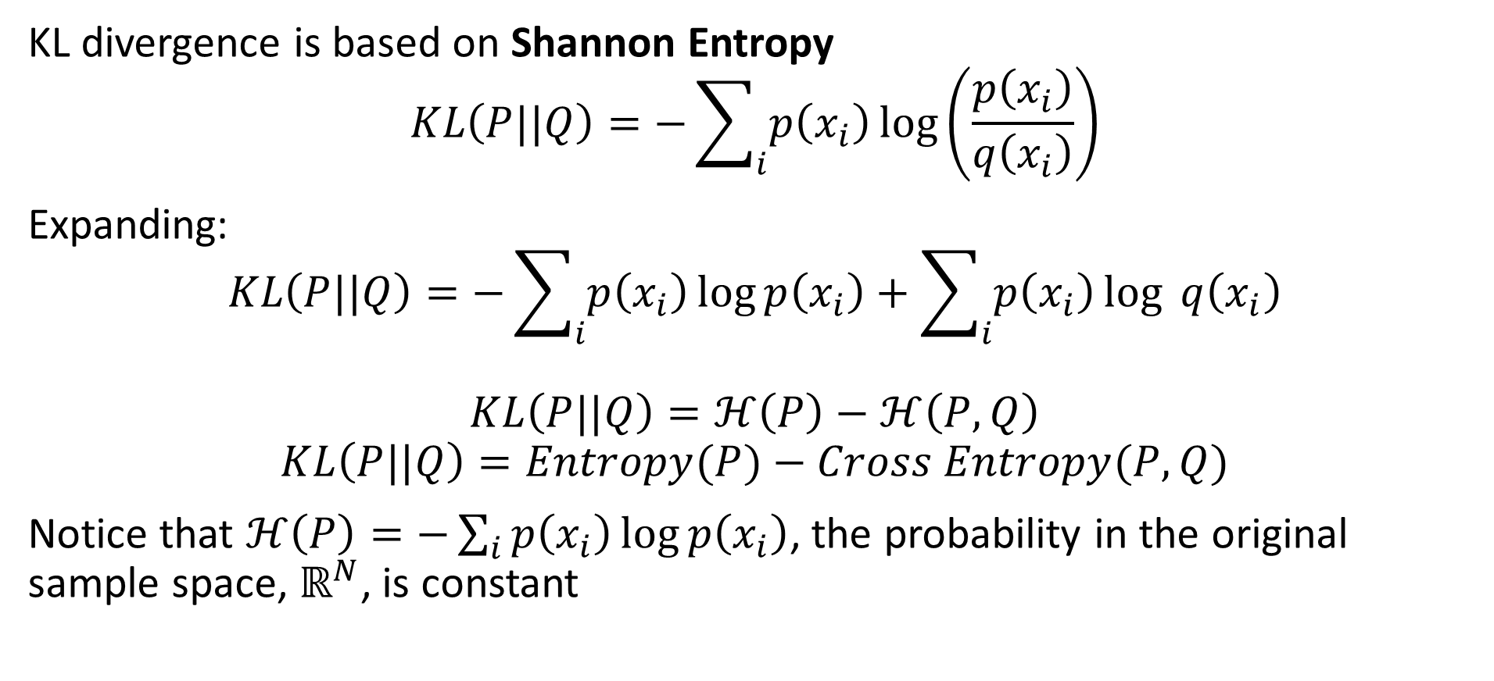
KL Divergence
KL divergence is based on Shannon Entropy
$$KL\left(P||Q\right)=−\sum_{i}{p\left(x_{i}\right)}\log\left(\frac{p\left(x_{i}\right)}{q\left(x_{i}\right)}\right)$$
Expanding:
$$KL\left(P||Q\right)=−\sum_{i}{p\left(x_{i}\right)}\log{p\left(x_{i}\right)}+\sum_{i}{p\left(x_{i}\right)}\log{q\left(x_{i}\right)}$$
$$KL\left(P||Q\right)=ℋ\left(P\right)−ℋ\left(P,Q\right)$$
$$KL\left(P||Q\right)=Entropy(P)−Cross Entropy(P,Q)$$
Notice that $ℋ\left(P\right)=−\sum_{i}{p\left(x_{i}\right)}\log{p\left(x_{i}\right)}$, the probability in the original sample space, $ℝ^{N}$, is constant

Slide 49
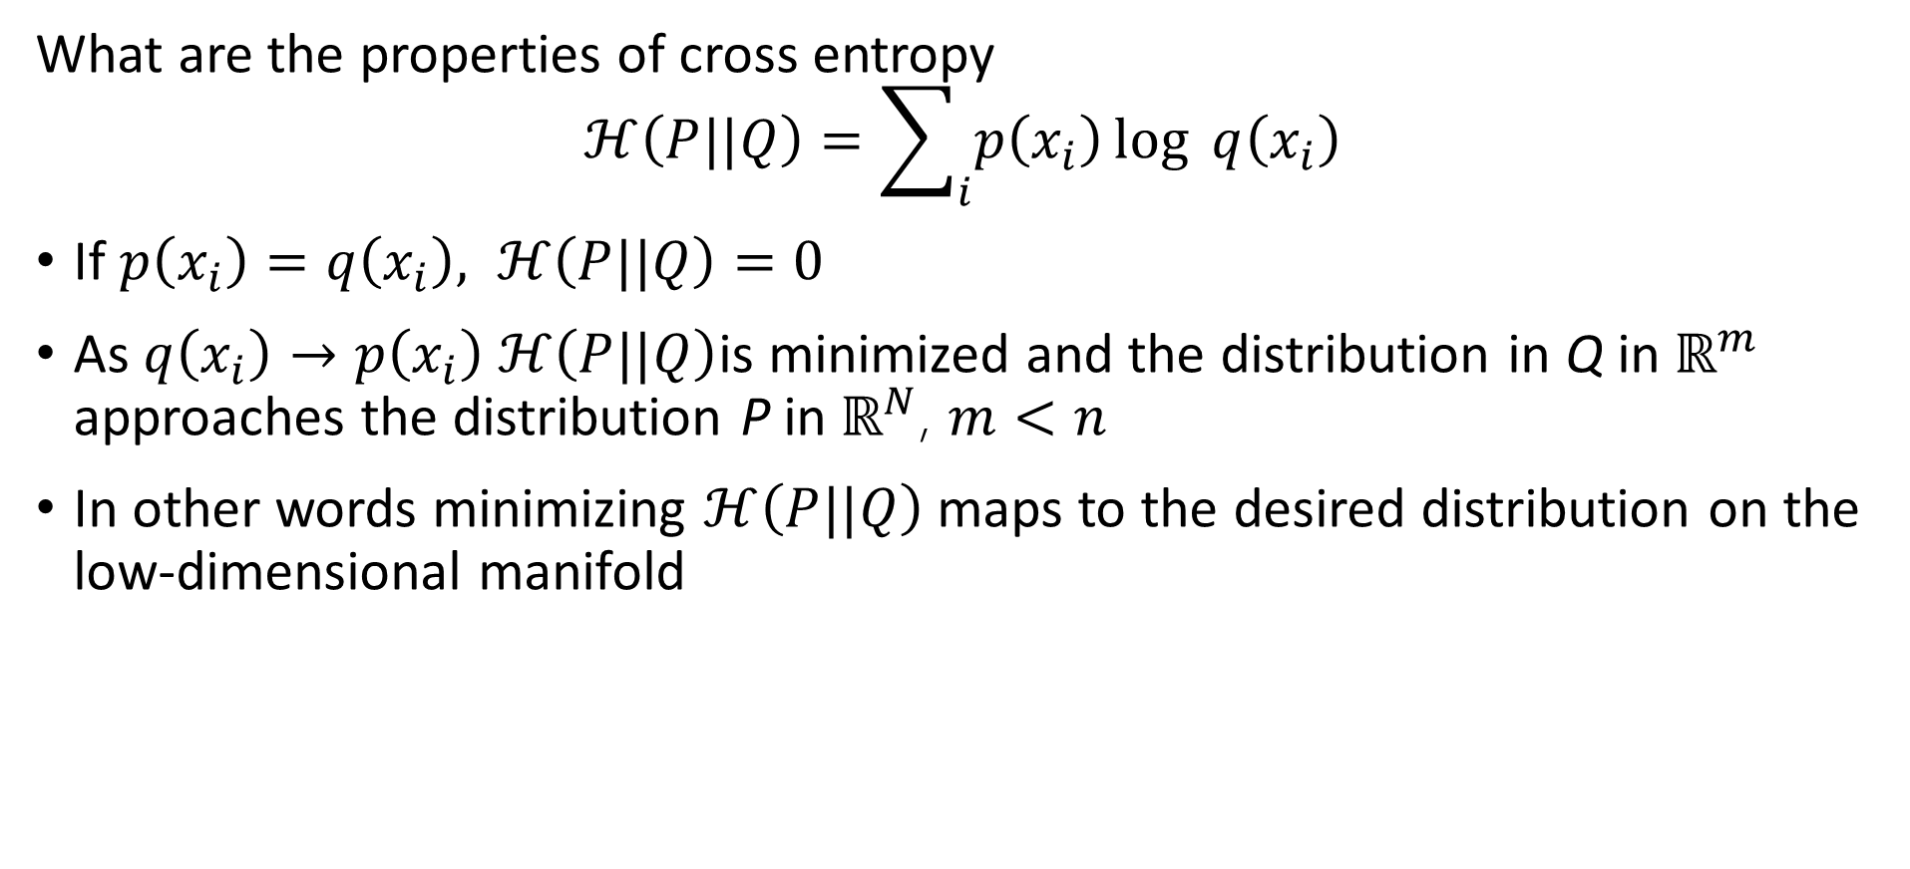
KL Divergence
What are the properties of cross entropy
$$ℋ\left(P||Q\right)=\sum_{i}{p\left(x_{i}\right)}\log{q\left(x_{i}\right)}$$
If $p\left(x_{i}\right)=q\left(x_{i}\right), ℋ\left(P||Q\right)=0$
As $q\left(x_{i}\right)→p\left(x_{i}\right) ℋ\left(P||Q\right)$is minimized and the distribution in Q in $ℝ^{m}$ approaches the distribution P in $ℝ^{N}$, $m<n$
In other words minimizing $ℋ\left(P||Q\right)$ maps to the desired distribution on the low-dimensional manifold

Slide 50
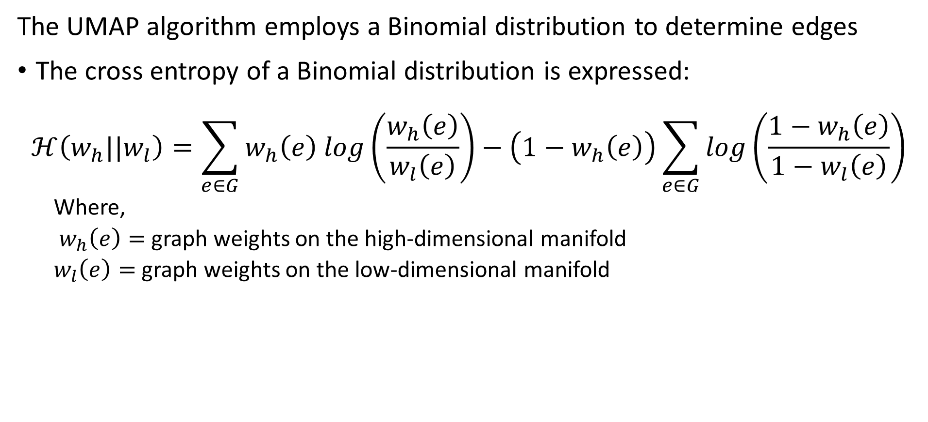
Uniform Manifold Approximation and Projection (UMAP)
The UMAP algorithm employs a Binomial distribution to determine edges
The cross entropy of a Binomial distribution is expressed:
$$ℋ\left(w_{h}||w_{l}\right)=\sum_{e∈G}^{ }{w_{h}\left(e\right) log\left(\frac{w_{h}\left(e\right)}{w_{l}\left(e\right)}\right)−\left(1−w_{h}\left(e\right)\right)\sum_{e∈G}^{ }{log\left(\frac{1−w_{h}\left(e\right)}{1−w_{l}\left(e\right)}\right)}}$$
Where,
$w_{h}\left(e\right)=$ graph weights on the high-dimensional manifold
$w_{l}\left(e\right)=$ graph weights on the low-dimensional manifold

Slide 51
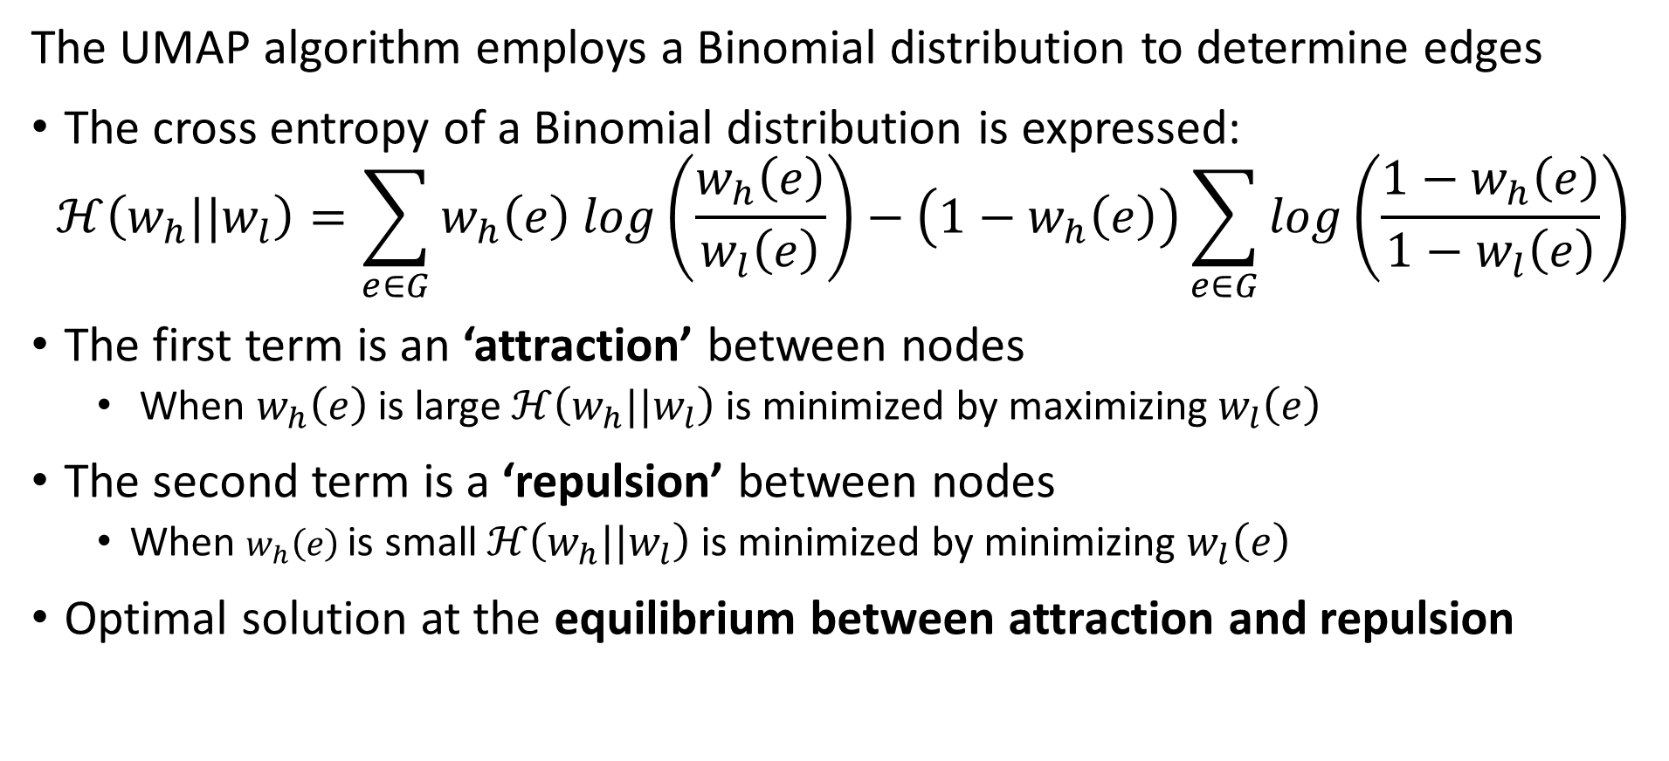
Uniform Manifold Approximation and Projection (UMAP)
The UMAP algorithm employs a Binomial distribution to determine edges
The cross entropy of a Binomial distribution is expressed:
$$ℋ\left(w_{h}||w_{l}\right)=\sum_{e∈G}^{ }{w_{h}\left(e\right) log\left(\frac{w_{h}\left(e\right)}{w_{l}\left(e\right)}\right)−\left(1−w_{h}\left(e\right)\right)\sum_{e∈G}^{ }{log\left(\frac{1−w_{h}\left(e\right)}{1−w_{l}\left(e\right)}\right)}}$$
The first term is an ‘attraction’ between nodes
When $w_{h}\left(e\right)$is large $ℋ\left(w_{h}||w_{l}\right)$ is minimized by maximizing $w_{l}\left(e\right)$
The second term is a ‘repulsion’ between nodes
When $w_{h}\left(e\right)$is small $ℋ\left(w_{h}||w_{l}\right)$ is minimized by minimizing $w_{l}\left(e\right)$
Optimal solution at the equilibrium between attraction and repulsion

Slide 52
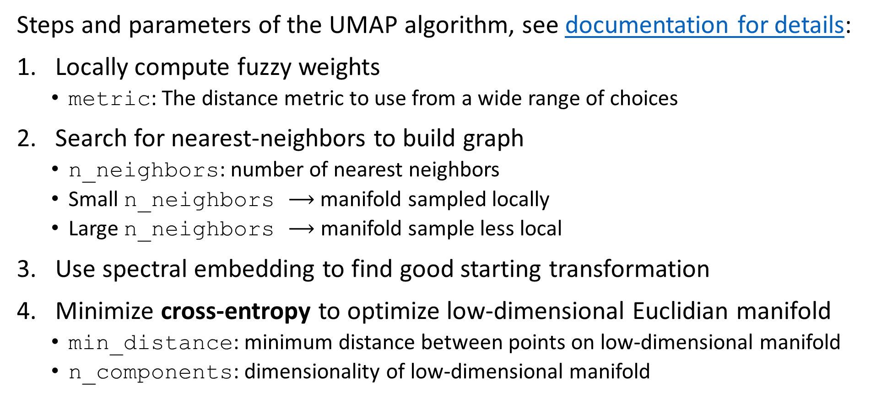
Uniform Manifold Approximation and Projection (UMAP)
Steps and parameters of the UMAP algorithm, see documentation for details:
Locally compute fuzzy weights
metric: The distance metric to use from a wide range of choices
Search for nearest-neighbors to build graph
n_neighbors: number of nearest neighbors
Small n_neighbors $⟶$ manifold sampled locally
Large n_neighbors $⟶$ manifold sample less local
Use spectral embedding to find good starting transformation
Minimize cross-entropy to optimize low-dimensional Euclidian manifold
min_distance: minimum distance between points on low-dimensional manifold
n_components: dimensionality of low-dimensional manifold

Slide 53
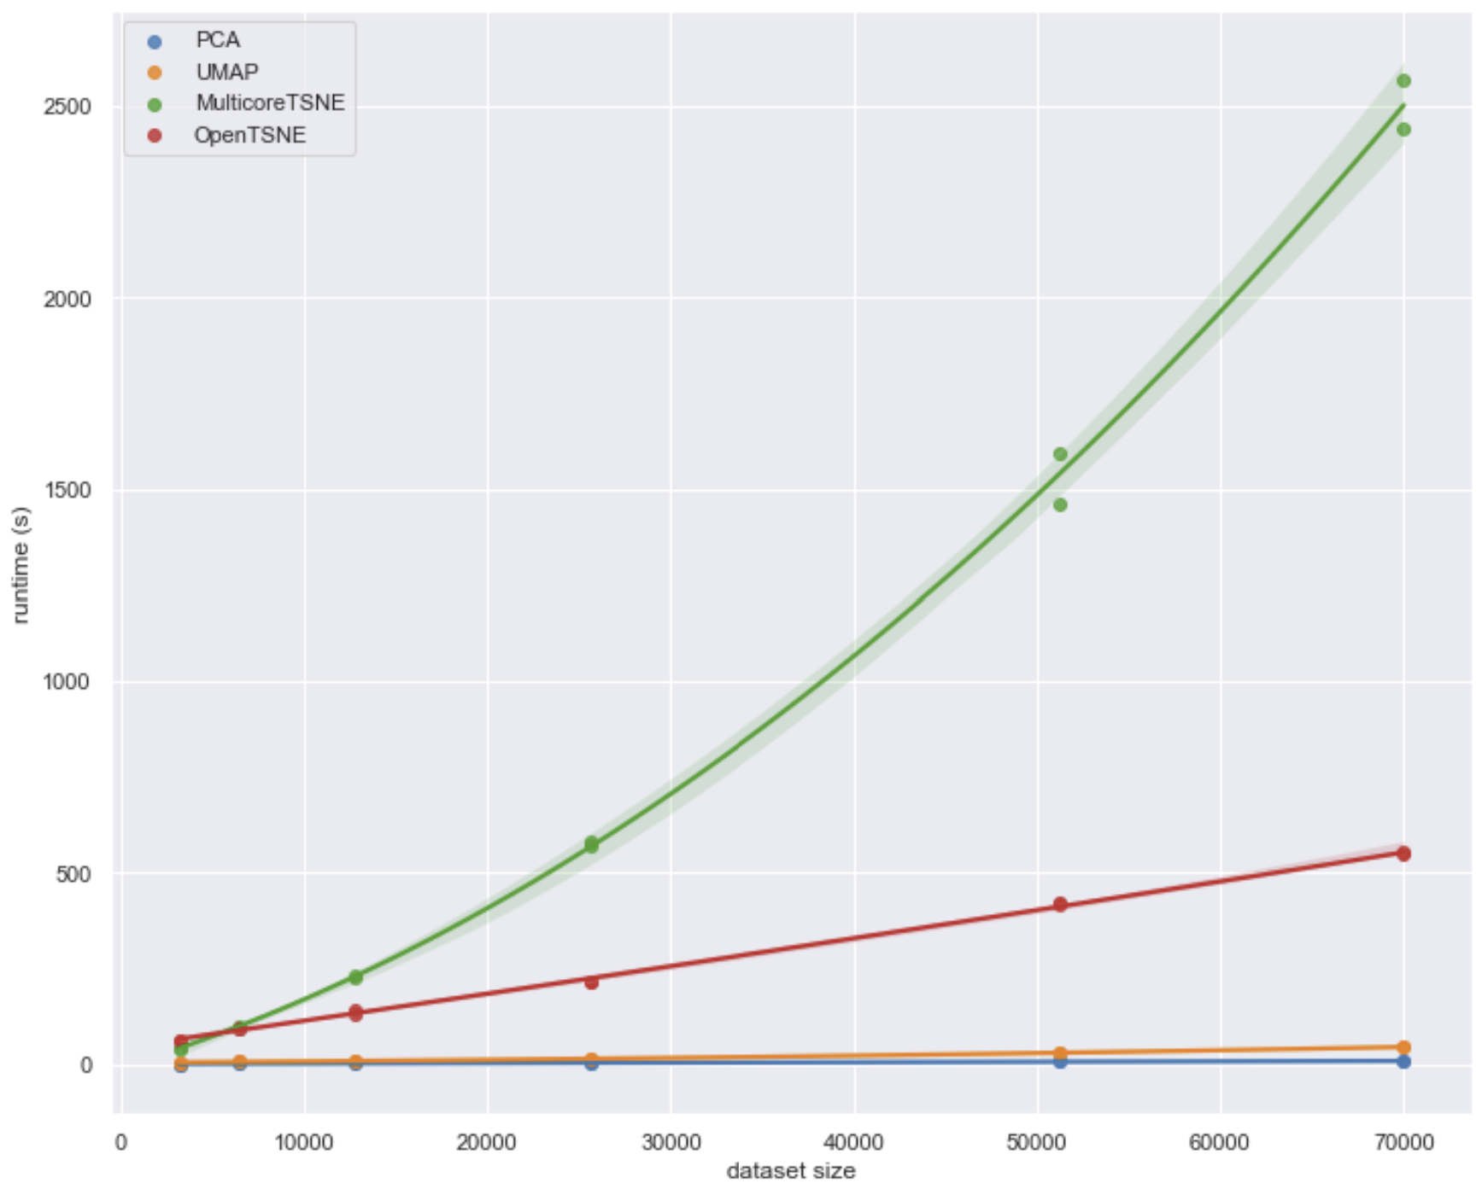
Uniform Manifold Approximation and Projection (UMAP)
How does UMAP performance compare?
From UMAP documentation, Leland McInnis, 2018

Slide 54
Summary
Dimensionality reduction is widely used in data mining
Review of high-dimensional spaces and the Curse of Dimensionality
Projection methods for high dimensions
Effective alternative to PCA
Bounds on distance error
Manifold learning and visualization in high dimensions
Project to low dimensional manifold
Can be distance preserving
UMAP is (arguably) the state of the art manifold learning algorithm

Slide 55
Appendix tSNE Algorithm

Slide 56
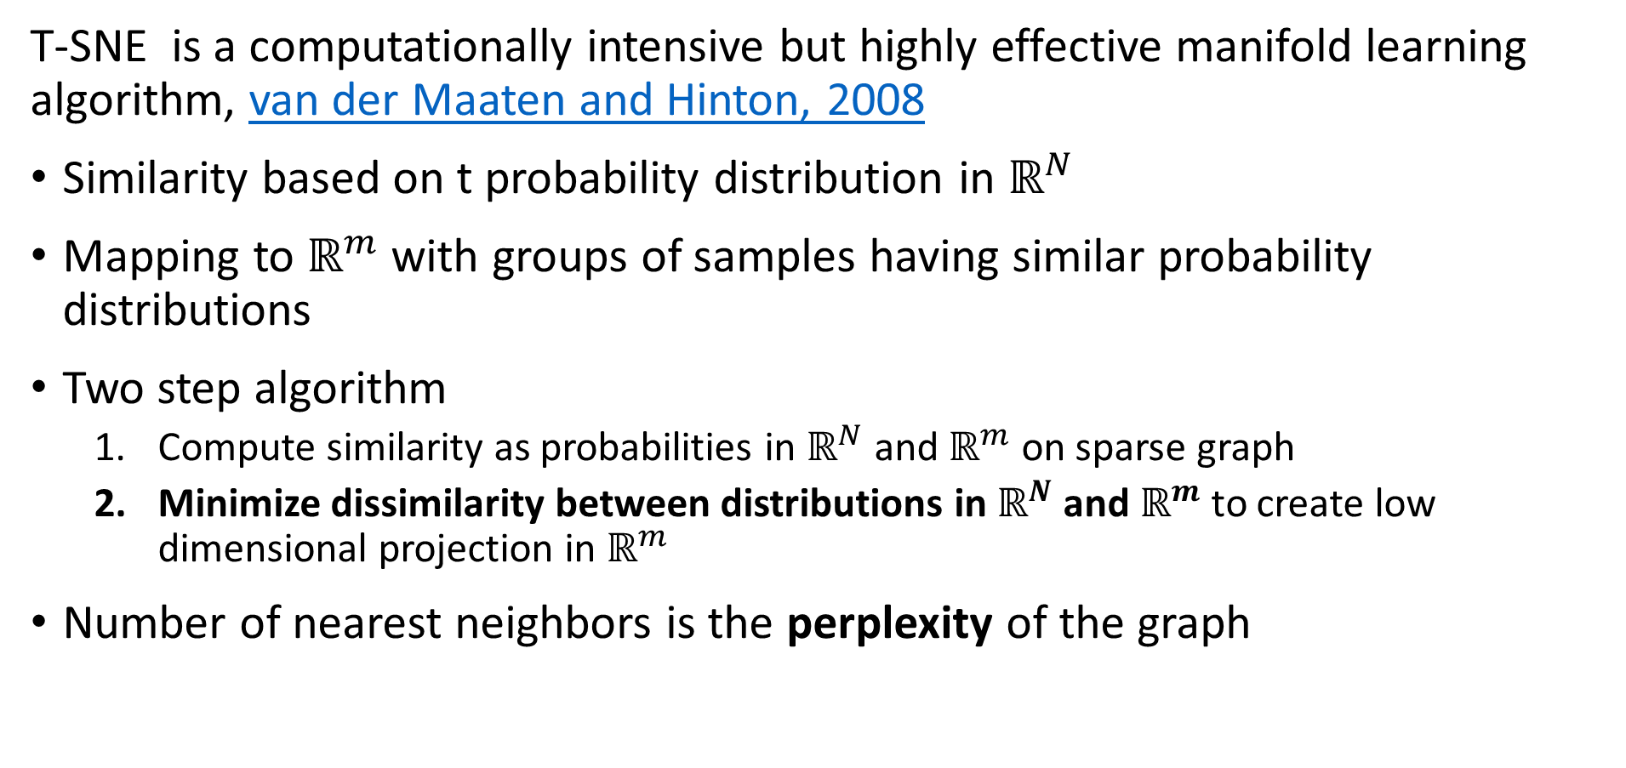
t-SNE
T-SNE is a computationally intensive but highly effective manifold learning algorithm, van der Maaten and Hinton, 2008
Similarity based on t probability distribution in $ℝ^{N}$
Mapping to $ℝ^{m}$ with groups of samples having similar probability distributions
Two step algorithm
Compute similarity as probabilities in $ℝ^{N}$ and $ℝ^{m}$ on sparse graph
Minimize dissimilarity between distributions in $ℝ^{N}$ and $ℝ^{m}$ to create low dimensional projection in $ℝ^{m}$
Number of nearest neighbors is the perplexity of the graph

Slide 57
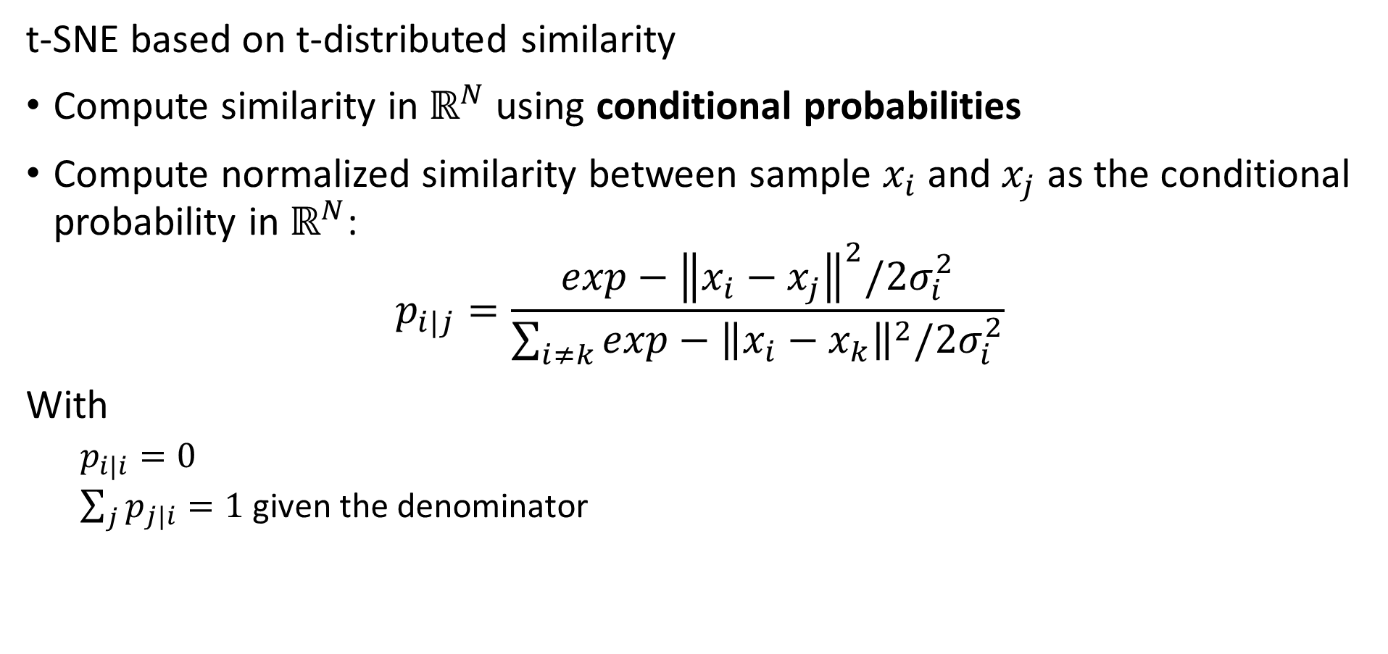
t-SNE
t-SNE based on t-distributed similarity
Compute similarity in $ℝ^{N}$ using conditional probabilities
Compute normalized similarity between sample $x_{i}$ and $x_{j}$ as the conditional probability in $ℝ^{N}$:
$$p_{i|j}=\frac{exp−{\left\|x_{i}−x_{j}\right\|}^{2}/2σ_{i}^{2}}{\sum_{i≠k}^{ }{exp−{\left\|x_{i}−x_{k}\right\|}^{2}/2σ_{i}^{2}}}$$
With
$p_{i|i}=0$
$\sum_{j}{p_{j|i}}=1$ given the denominator

Slide 58
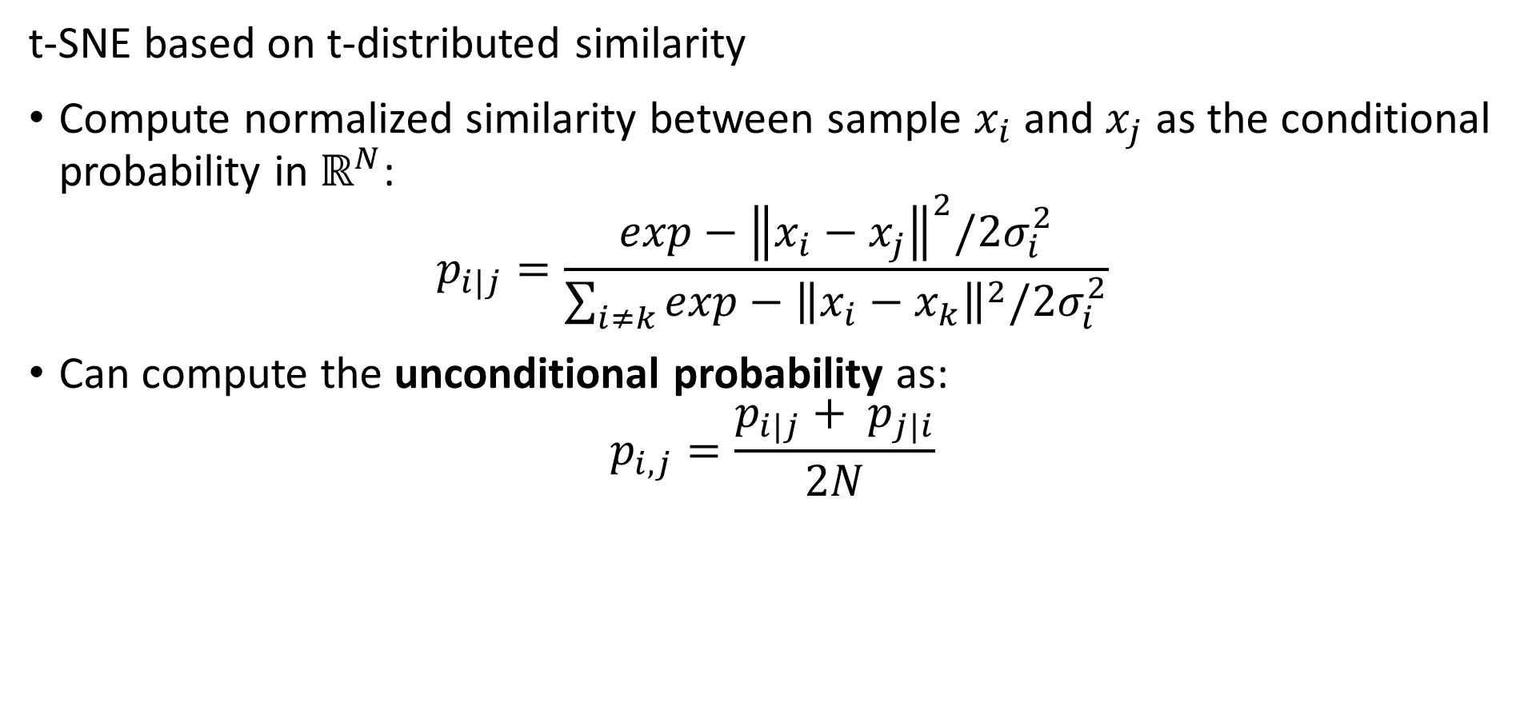
t-SNE
t-SNE based on t-distributed similarity
Compute normalized similarity between sample $x_{i}$ and $x_{j}$ as the conditional probability in $ℝ^{N}$:
$$p_{i|j}=\frac{exp−{\left\|x_{i}−x_{j}\right\|}^{2}/2σ_{i}^{2}}{\sum_{i≠k}^{ }{exp−{\left\|x_{i}−x_{k}\right\|}^{2}/2σ_{i}^{2}}}$$
Can compute the unconditional probability as:
$$p_{i,j}=\frac{p_{i|j}+ p_{j|i}}{2N}$$

Slide 59
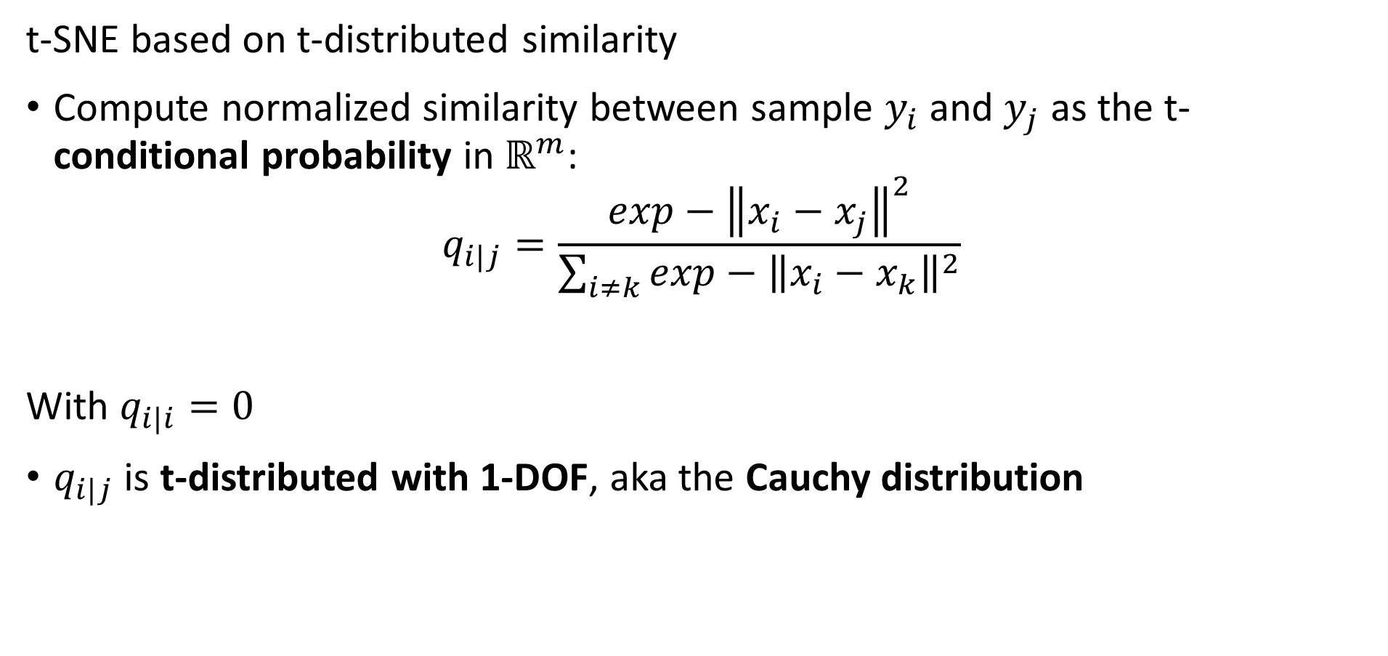
t-SNE
t-SNE based on t-distributed similarity
Compute normalized similarity between sample $y_{i}$ and $y_{j}$ as the t-conditional probability in $ℝ^{m}$:
$$q_{i|j}=\frac{exp−{\left\|x_{i}−x_{j}\right\|}^{2}}{\sum_{i≠k}^{ }{exp−{\left\|x_{i}−x_{k}\right\|}^{2}}}$$
With $q_{i|i}=0$
$q_{i|j}$ is t-distributed with 1-DOF, aka the Cauchy distribution

Slide 60
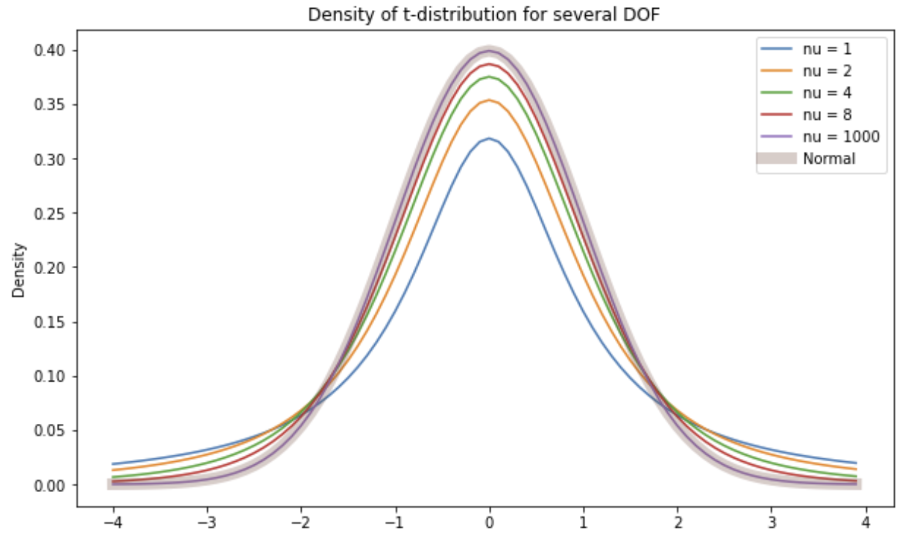
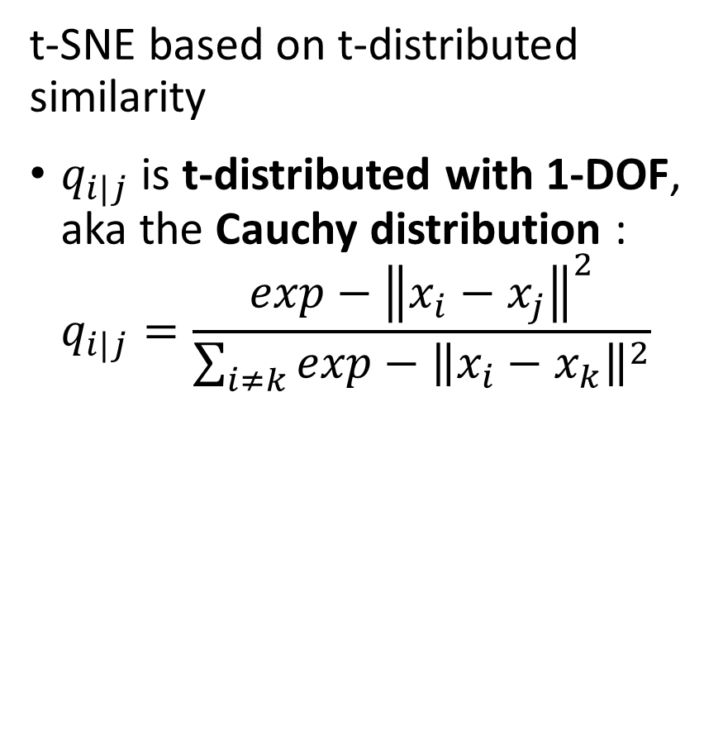
t-SNE
t-SNE based on t-distributed similarity
$q_{i|j}$ is t-distributed with 1-DOF, aka the Cauchy distribution :
$$q_{i|j}=\frac{exp−{\left\|x_{i}−x_{j}\right\|}^{2}}{\sum_{i≠k}^{ }{exp−{\left\|x_{i}−x_{k}\right\|}^{2}}}$$

Slide 61
t-SNE
t-SNE based on t-distributed similarity
Why is the t-distribution a good choice
Notice that for the Normal distribution probability low for samples far from the center
t-distribution has reasonable probability further from center
t-distribution with 1 DOF has heaviest tail

Slide 62
Uniform Manifold Approximation and Projection (UMAP)
How does the UMAP algorithm work?
Algorithm for mapping to low dimensional Euclidian space has 4 major steps:
Locally compute fuzzy weights
Search for nearest-neighbors to build graph
Use spectral embedding to find good starting transformation
Minimize cross-entropy to optimize low-dimensional Euclidian manifold

Slide 63
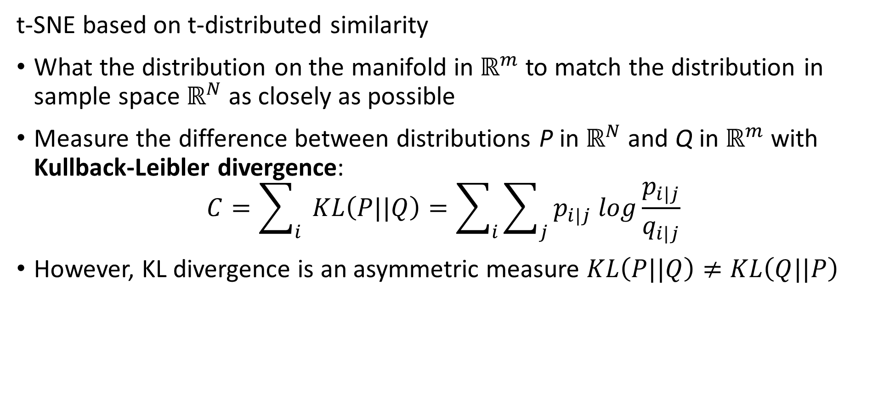
t-SNE
t-SNE based on t-distributed similarity
What the distribution on the manifold in $ℝ^{m}$ to match the distribution in sample space $ℝ^{N}$ as closely as possible
Measure the difference between distributions P in $ℝ^{N}$ and Q in $ℝ^{m}$ with Kullback-Leibler divergence:
$$C=\sum_{i}{ }KL\left(P||Q\right)=\sum_{i}{\sum_{j}{p_{i|j} log\frac{p_{i|j}}{q_{i|j}}}}$$
However, KL divergence is an asymmetric measure $KL\left(P||Q\right)≠KL\left(Q||P\right)$

Slide 64
T-SNE
The KL divergence is asymmetric
For two distributions the KL divergence depend on the order or arguments
Notice that the gradient becomes near zero on one side of the KL function

Slide 65

KL Divergence
KL divergence is based on Shannon Entropy
For information content of set of samples X, $I(X)$, the Shannon entropy $ℋ(X)$:
$$ℋ\left(X\right)=E\left[I(X)\right]$$
In terms of probabilities we can express Shannon entropy
$$ℋ\left(X\right)=E\left[{−log}_{b} P(X)\right]=\sum_{i}{P\left(x_{i}\right) \log_{b} P\left(x_{i}\right)}$$
What are some properties of Shannon entropy
The less predictable the outcome the higher the entropy
Example: if outcome is always the same $ℋ\left(X\right)=0$
Example: if outcome is completely random $ℋ\left(X\right)=maximum$

Slide 66
KL Divergence
Events with random outcome have maximum entropy, $\operatorname{Pr}\left(X=1\right)=0.5$
Understanding Shannon Entropy
Example: binomially distributed events
Events with known outcome have 0 entropy, $\operatorname{Pr}\left(X=1\right)=\{0 or 1\}$
Credit: Wikipedia commons

Slide 67
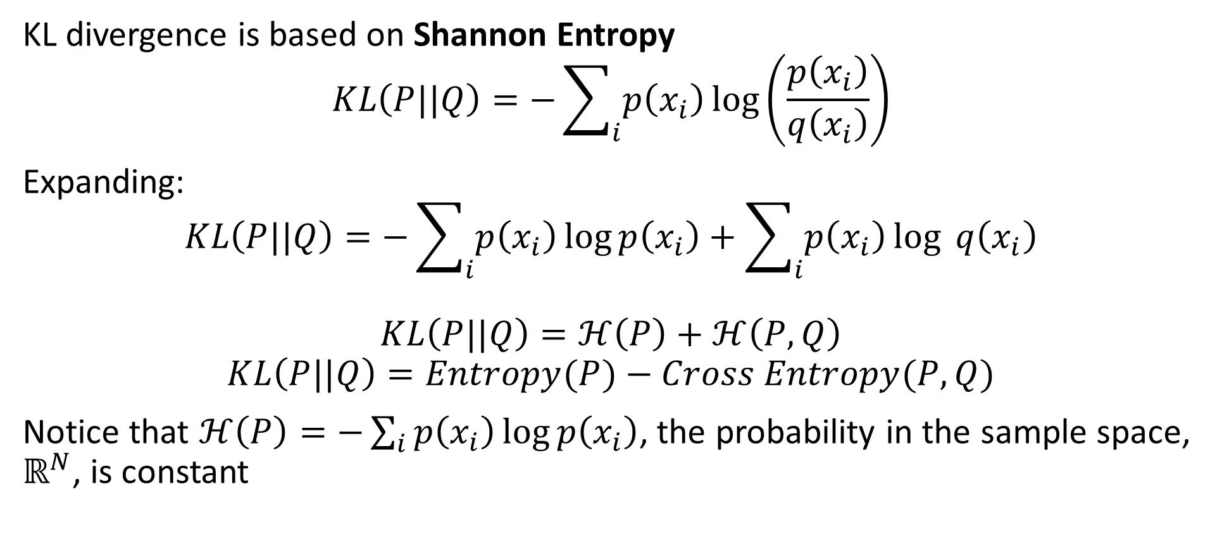
KL Divergence
KL divergence is based on Shannon Entropy
$$KL\left(P||Q\right)=−\sum_{i}{p\left(x_{i}\right)}\log\left(\frac{p\left(x_{i}\right)}{q\left(x_{i}\right)}\right)$$
Expanding:
$$KL\left(P||Q\right)=−\sum_{i}{p\left(x_{i}\right)}\log{p\left(x_{i}\right)}+\sum_{i}{p\left(x_{i}\right)}\log{q\left(x_{i}\right)}$$
$$KL\left(P||Q\right)=ℋ\left(P\right)+ℋ\left(P,Q\right)$$
$$KL\left(P||Q\right)=Entropy(P)−Cross Entropy(P,Q)$$
Notice that $ℋ\left(P\right)=−\sum_{i}{p\left(x_{i}\right)}\log{p\left(x_{i}\right)}$, the probability in the sample space, $ℝ^{N}$, is constant

Slide 68
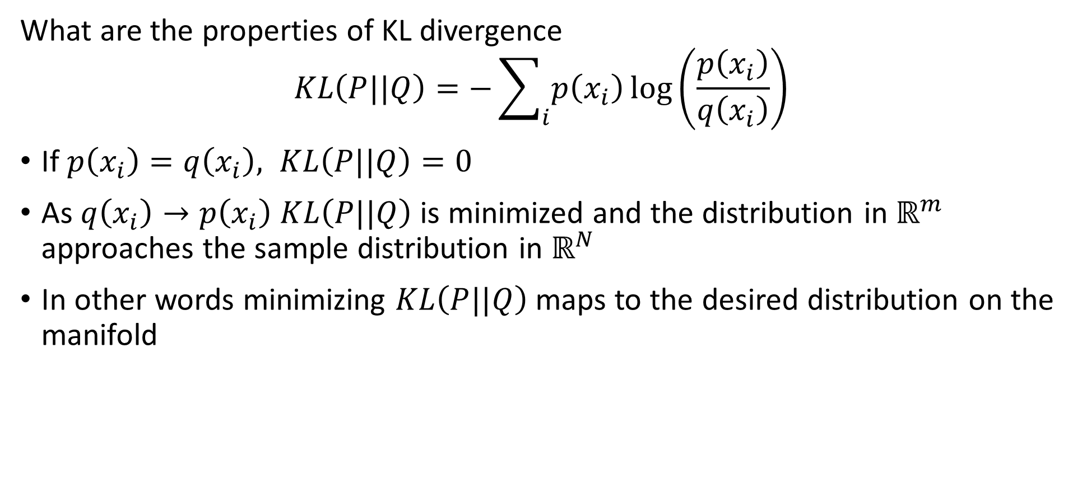
KL Divergence
What are the properties of KL divergence
$$KL\left(P||Q\right)=−\sum_{i}{p\left(x_{i}\right)}\log\left(\frac{p\left(x_{i}\right)}{q\left(x_{i}\right)}\right)$$
If $p\left(x_{i}\right)=q\left(x_{i}\right), KL\left(P||Q\right)=0$
As $q\left(x_{i}\right)→p\left(x_{i}\right)$ $KL\left(P||Q\right)$is minimized and the distribution in $ℝ^{m}$ approaches the sample distribution in $ℝ^{N}$
In other words minimizing $KL\left(P||Q\right)$ maps to the desired distribution on the manifold

Slide 69
Summary
Dimensionality reduction is widely used in data mining
Review of high-dimensional spaces and the Curse of Dimensionality
Projection methods for high dimensions
Highly efficient alternative to PCA
Bounds on distance error
Manifold learning and visualization in high dimensions
Project to low dimensional manifold
Not distance preserving

Slide 70
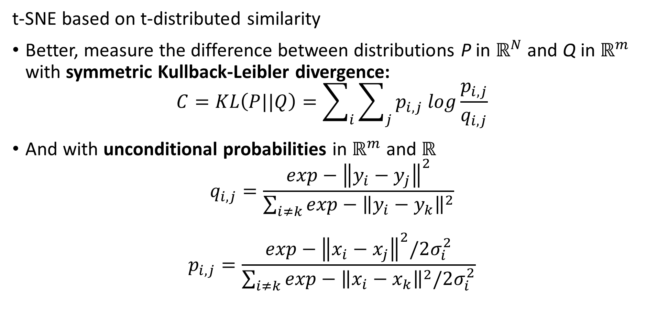
t-SNE
t-SNE based on t-distributed similarity
Better, measure the difference between distributions P in $ℝ^{N}$ and Q in $ℝ^{m}$ with symmetric Kullback-Leibler divergence:
$$C=KL\left(P||Q\right)=\sum_{i}{\sum_{j}{p_{i,j} log\frac{p_{i,j}}{q_{i,j}}}}$$
And with unconditional probabilities in $ℝ^{m}$ and $ℝ^{}$
$$q_{i,j}=\frac{exp−{\left\|y_{i}−y_{j}\right\|}^{2}}{\sum_{i≠k}^{ }{exp−{\left\|y_{i}−y_{k}\right\|}^{2}}}$$
$$p_{i,j}=\frac{exp−{\left\|x_{i}−x_{j}\right\|}^{2}/2σ_{i}^{2}}{\sum_{i≠k}^{ }{exp−{\left\|x_{i}−x_{k}\right\|}^{2}/2σ_{i}^{2}}}$$

Slide 71
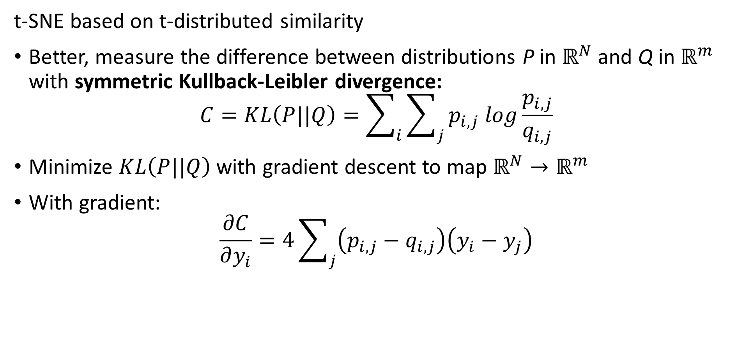
t-SNE
t-SNE based on t-distributed similarity
Better, measure the difference between distributions P in $ℝ^{N}$ and Q in $ℝ^{m}$ with symmetric Kullback-Leibler divergence:
$$C=KL\left(P||Q\right)=\sum_{i}{\sum_{j}{p_{i,j} log\frac{p_{i,j}}{q_{i,j}}}}$$
Minimize $KL\left(P||Q\right)$ with gradient descent to map $ℝ^{N}→ℝ^{m}$
With gradient:
$$\frac{∂C}{∂y_{i}}=4\sum_{j}{\left(p_{i,j}−q_{i,j}\right)\left(y_{i}−y_{j}\right)}$$

Slide 72
t-SNE
t-SNE based on t-distributed similarity
Better, measure the difference between distributions P in $ℝ^{N}$ and Q in $ℝ^{m}$ with symmetric Kullback-Leibler divergence:
$$C=KL\left(P||Q\right)=\sum_{i}{\sum_{j}{p_{i,j} log\frac{p_{i,j}}{q_{i,j}}}}$$
Minimize $KL\left(P||Q\right)$ with gradient descent to map $ℝ^{N}→ℝ^{m}$
With gradient:
$$\frac{∂C}{∂y_{i}}=4\sum_{j}{\left(p_{i,j}−q_{i,j}\right)\left(y_{i}−y_{j}\right)}$$

Slide 73
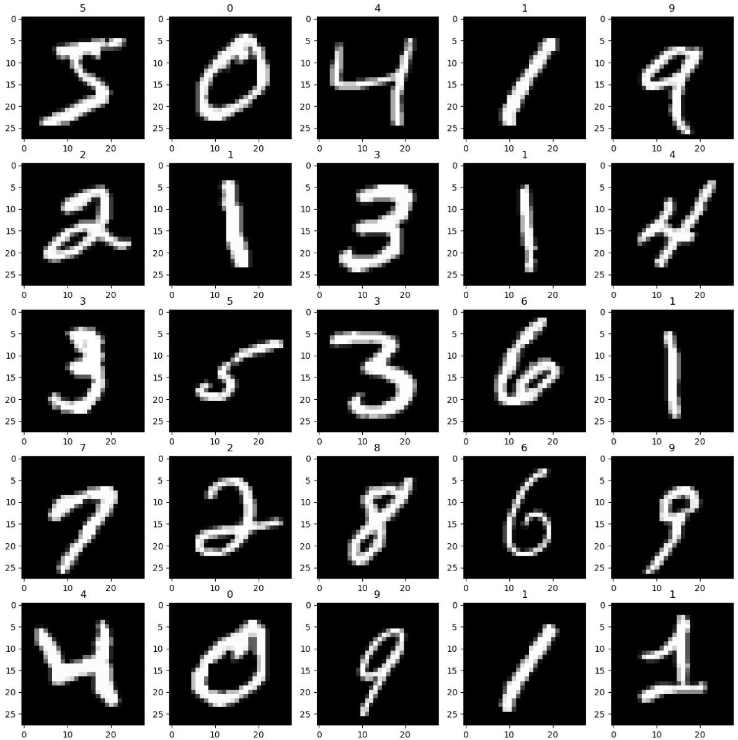
Example t-SNE vs. PCA
Use the pixel values of handwritten MNIST digits dataset

Slide 74
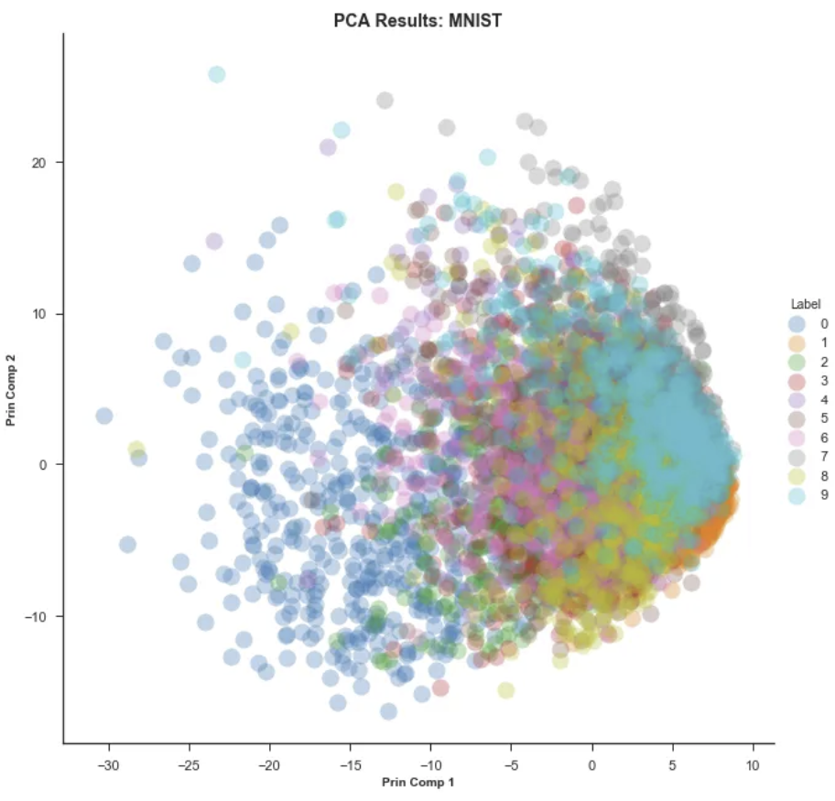
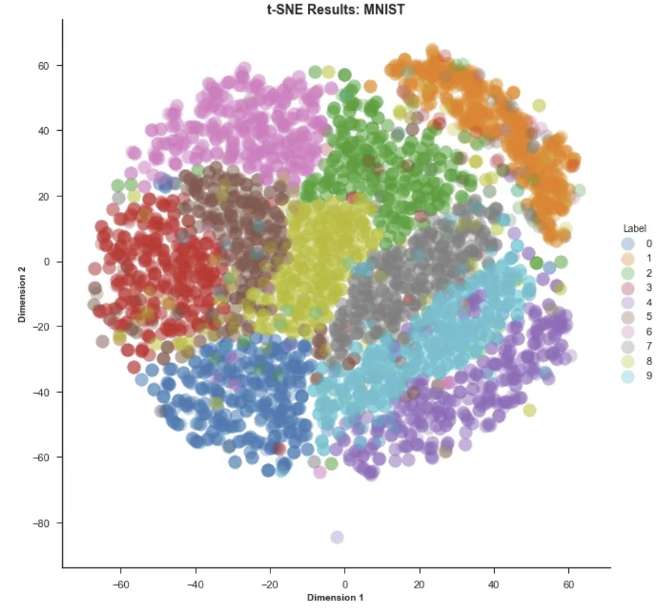
Example t-SNE vs. PCA
First 2 PCs, linear manifold
t-SNE, perplexity = 50
From blog post by Andrey Violante

